Slide 1
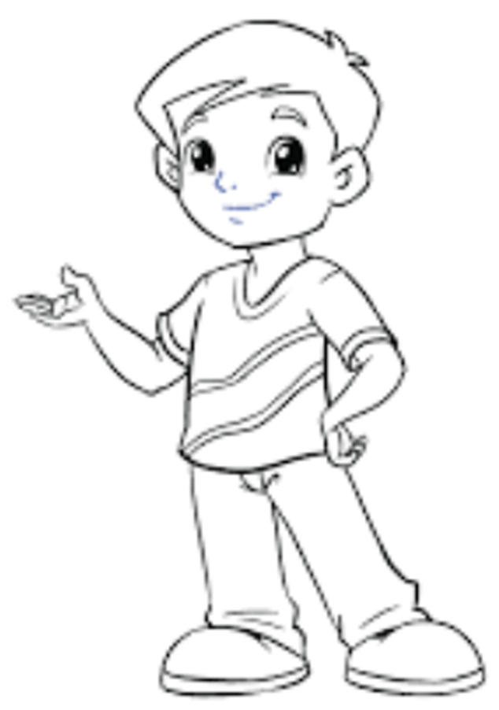


A Character Curriculum
Julie Norman
Crowcombe & Stogumber Primary Schools
Julie Norman Version 1 05 01 2020
© Copyright 2019 Julie & Andy Norman. All Rights Reserved.
Protected with www.ProtectMyWork.com, Reference Number: 7690020819S023
Notes:
We should fill their heads with knowledge then they can pass tests because the government always know best and that is our purpose….said no Headteacher EVER!
Are we teaching children how to pass a test? Or to live as productive, compassionate citizens?
Do we teach character?
Or is it a ‘bolt on’ to the curriculum?

Slide 2
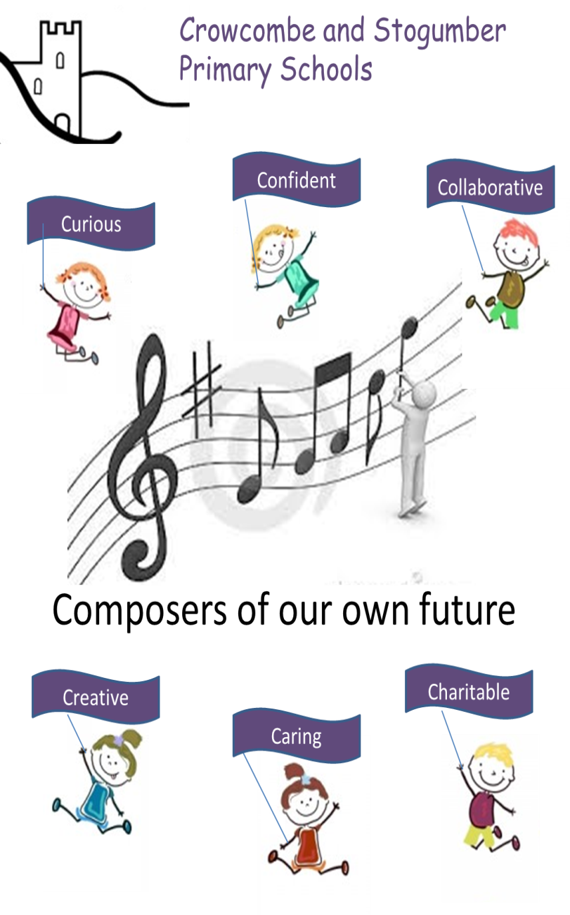

Slide 3
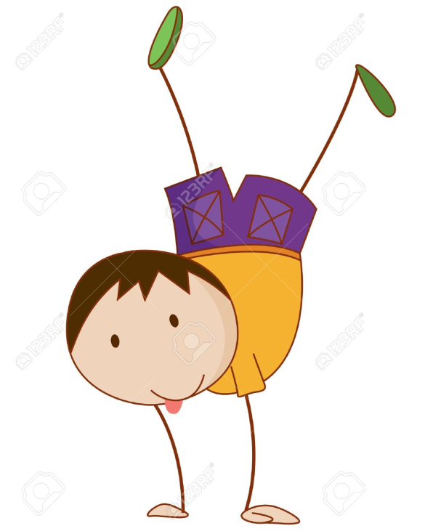
These aims rely on:
The teacher!
Lessons plans showing ways of working in class, having a bond and love for the children, being creative thinkers and planning investigative lessons….
If we are to remove workload then we cannot micro manage teachers and pull in lesson plans every week or tell teachers HOW to teach so they can become Outstanding…..
Therefore, these become a ‘bolt on’ to the curriculum.
Time to turn it
on it’s head?

Slide 4
‘Composers of our own future’? Are we?
If we teach children facts and how to remember them are we preparing them for their future?
If so, what future are we preparing them for exactly?
What are they learning that will help in their jobs in 10-20years time?
Can you answer these questions:
If we don’t know the answer to these questions then how do we prepare them for a rapidly changing world?
What jobs are they going to be doing?
What business will they be involved in ?
What technology will they be using?
We change the aims!!!

Slide 5

Hi, I’m 5. I want to be prepared to go for the best job
on offer in 2045.
What technology can I use in class to help me?
How will I know what businesses will want from me?
What knowledge do I need?
What kind of job will be on offer for me?

Slide 6
Intent?
What are our curriculum objectives? What do we want pupils to be able to know and do by the time they leave?
How does our curriculum plan set out the sequence and structure of how we will implement it?
How does our curriculum reflect national policy (for example, British values, or PSHE)?
How does it cater for disadvantaged and minority groups? How do we make sure these pupils aren't 'shut out‘ of pursuing subjects they wish to study because of too sharp a focus on exam results?
To what extent have we made the objectives clear? Does everybody know them?

Slide 8
Implementation?
How does our current curriculum match our intention ?
What subjects are we not teaching?
How do the subjects we are teaching join together? What cross-curricular links are there (in particular in the development of literacy and numeracy)?
How are we encouraging progression as pupils move through the school?
How do we differentiate our curriculum for different ability groups?
Are subjects staffed appropriately? Are staff trained? Do subjects have adequate time and other resources?

Slide 9
Subjects:
Intellectual and Informed Character
A Sense of the World
(Awe, wonder and Enquiry)
Developmental Character
A Sense of Self
Moral and Spiritual Character
A Sense of Others

Slide 10
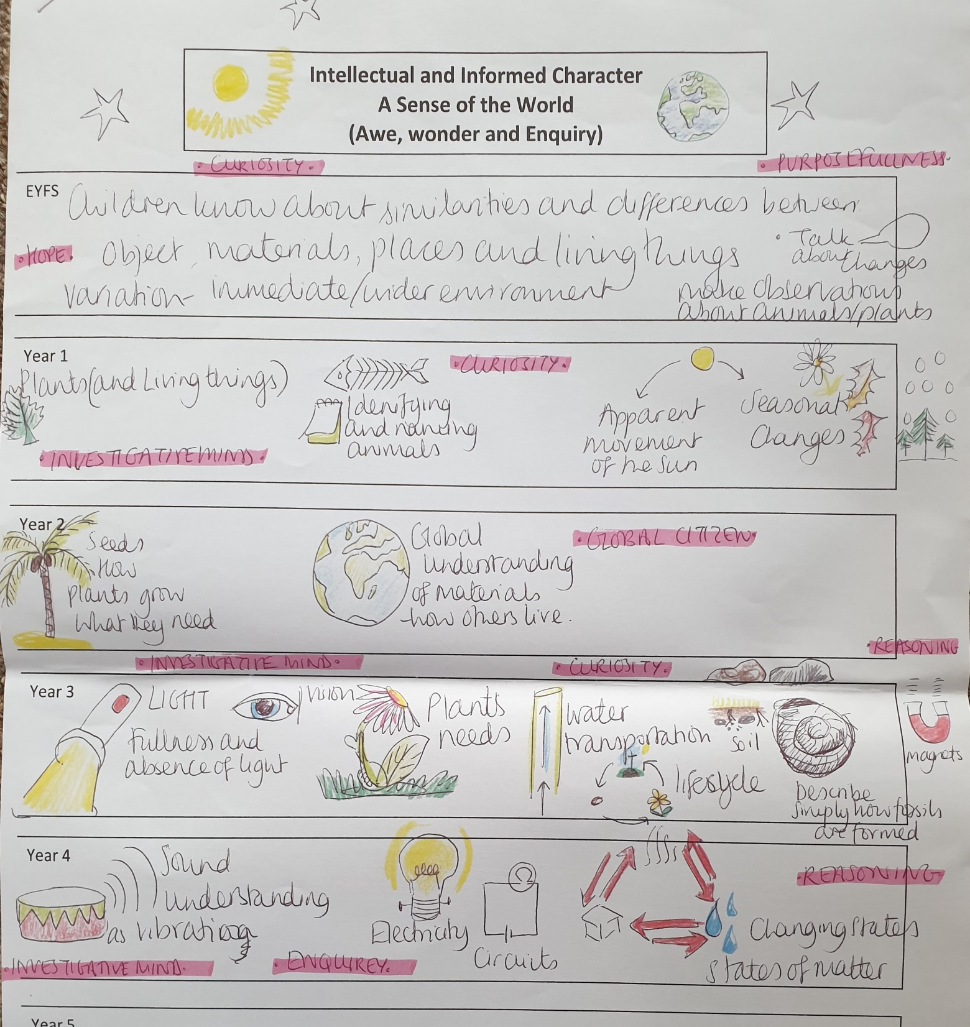
science

Slide 11
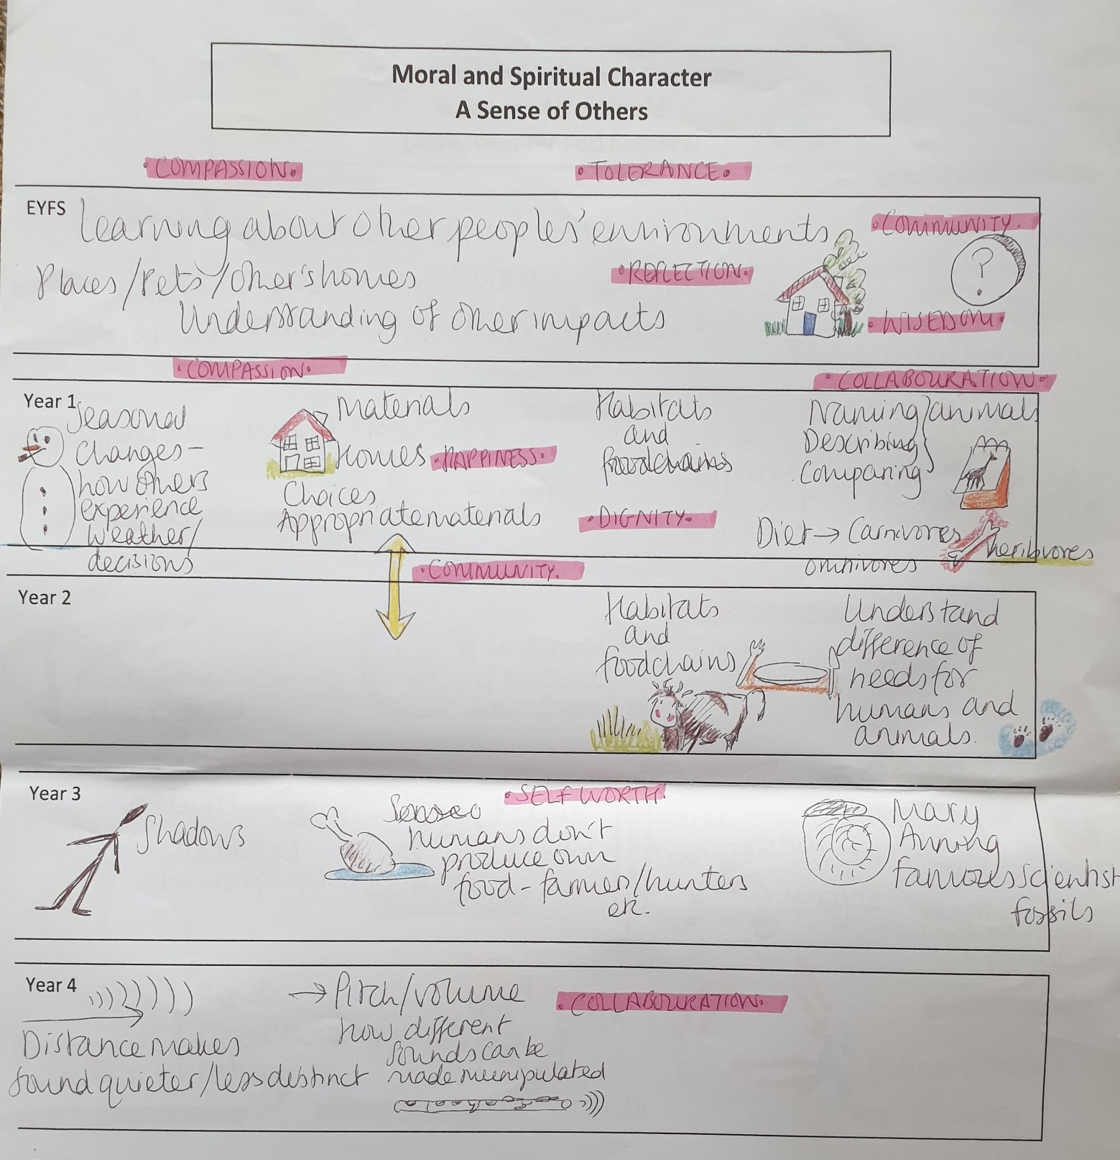

Slide 12
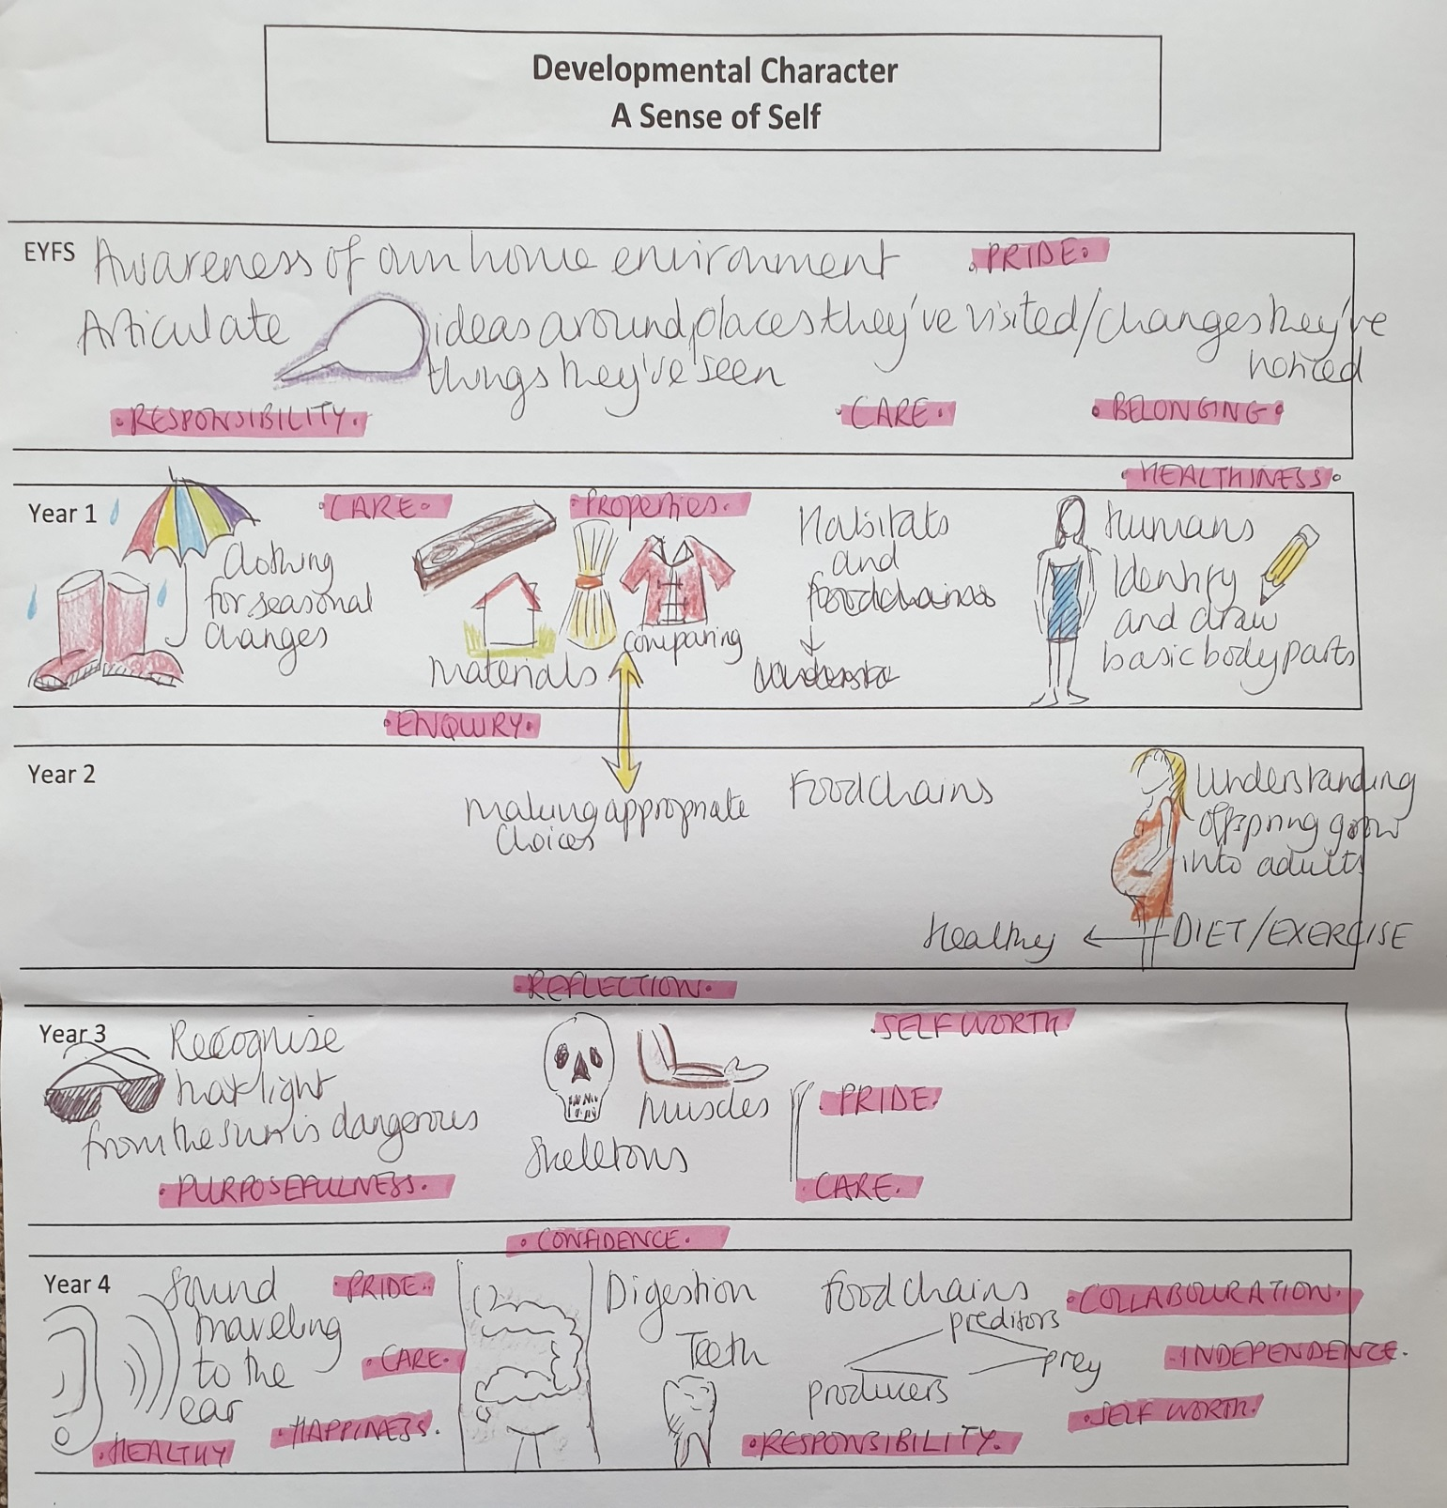

Slide 13

Projects:
Take a topics from the world today: Climate change etc
Year 1: Sense of the world, sense of others & sense of self
For all areas of the curriculum such as science, geography, history, (RE), Art, DT, Music, Applied maths, literature, physical education, PSHE, Citizenship, philosophy etc.
Explicitly teach literacy skills and maths skills
End the term with a huge celebration of learning – information shared through a play, music, artwork, DT and share your message with the world.
Be an incredible citizen driving a vehicle of knowledge to create change!
Notes:
For example, the children in KS2 wanted to highlight the issues around climate change and how we can make small changes in our lives to positively impact the greater cause. The children pooled together what they thought they already knew as a starting point. They were inspired by Greta – young activist, then did their research based on what they had heard. What was true? What was myth? They use Blooms to work through their thinking….
what are the facts…recall the facts,
Interpreting the information and getting some understanding
Applying what we know to the world around us and how we live our lives
Examine more closely – analyse the relationships
Evaluate the outcomes and make judgements – come to conclusions
Use this information to encourage CHANGE!
Find a way to share this with everyone in your community

Slide 14
Impact?
How well are children learning the content outlined in the curriculum? How do we know?
How well are pupils prepared for their next stage of education or working life?
How do we know our curriculum is having an effect across all pupils, including those who are disadvantaged or have low attainment?
For teachers
How well are key subject knowledge and skills consolidated before moving onto the next topic? How do we know?
How well-developed are pupils’ learning habits and learning skills? How do we know?
How do we use evidence of pupils’ learning to feed into our planning and adaptation of the curriculum?
Notes:
Behaviour – children write the behaviour policy
Marking – children write the policy – see saw
Loops for learning – children design the medium term planning and final celebration – play, script, music or project outcome.
Ofsted – if it were Sept19 you would easily be Outstanding. The children are not normal! You have a very special place here.

Slide 15
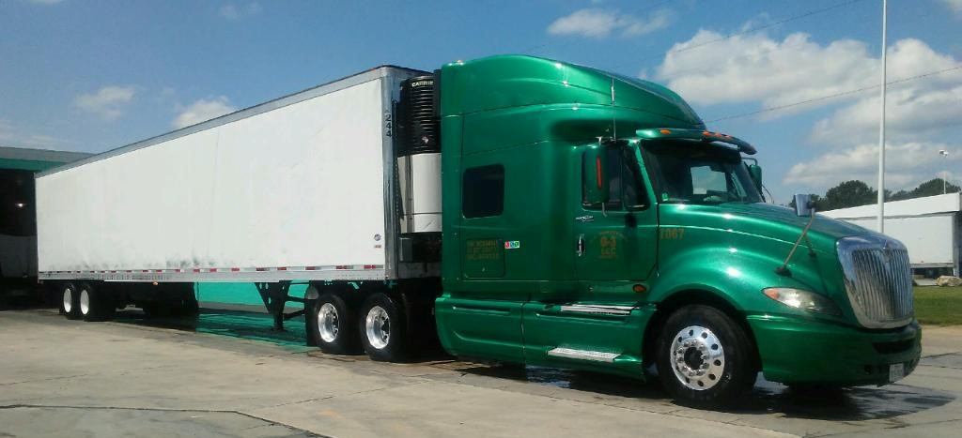
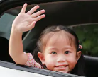

knowledge
Now we are:
Composers of our
own future!
Notes:
We send children out of Primary with characteristics which allow them to do whatever they want to do in this world, with the confidence to do it, the resilience for set backs, the curiosity to be life long learners and the humility to play a vital role in society for change.
What job will they do? We don’t know but they do not have to decide today!

