Slide 1
Changes
What kind of changes
do we have to face?
How do you cope?

Slide 2
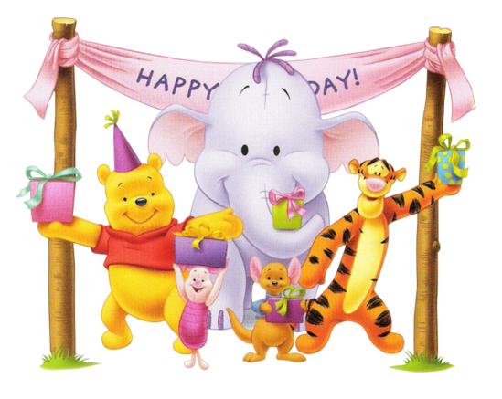
Have a birthday

Slide 3
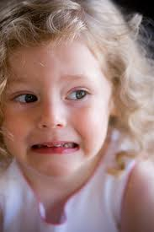
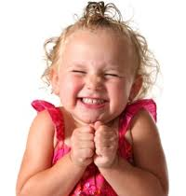
How does it make you feel?

Slide 4
Summer has arrived and it is hot and sunny

Slide 5
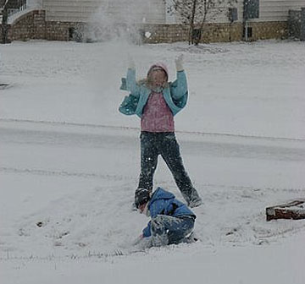
School closes because it is snowing

Slide 6
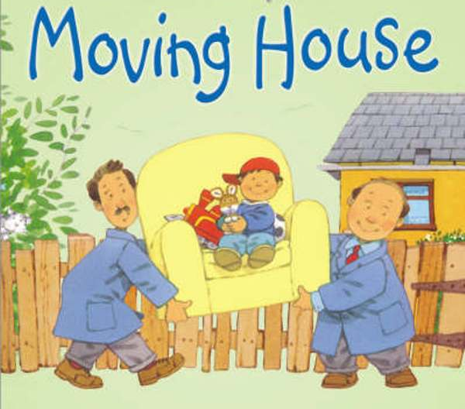

Slide 7
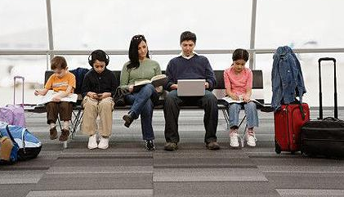
A friend moving to another country

Slide 8
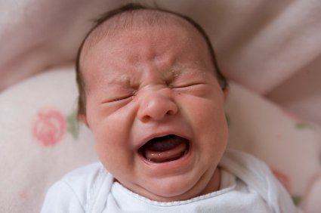
A new baby brother or sister

Slide 9
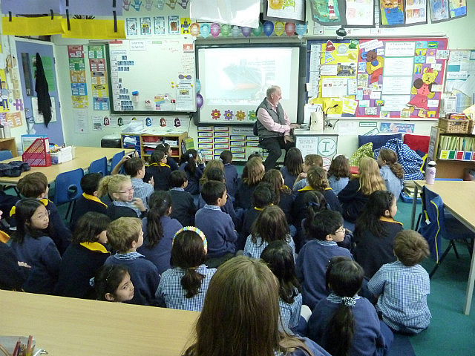
Moving into a new class

Slide 10
Are you a
positive thinker?
Are you a
negative thinker?

