Slide 1

Compassion
How does our world show compassion?

Slide 2
compassion
noun
sympathetic pity and concern for the sufferings or misfortunes of others.
Compassion motivates people to go out of their way to help.

Slide 3
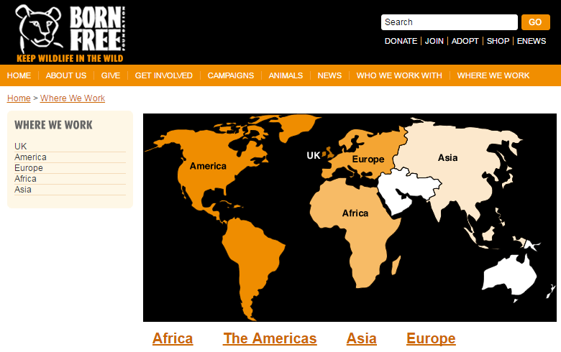
Born Free – helping wild animals all over the world who need protection.

Slide 4
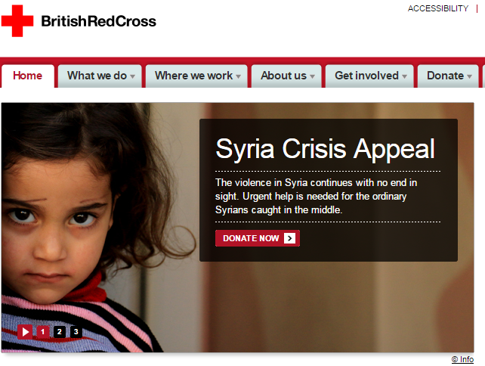
British Red Cross – helping people who need safety from war or devastation.

Slide 5
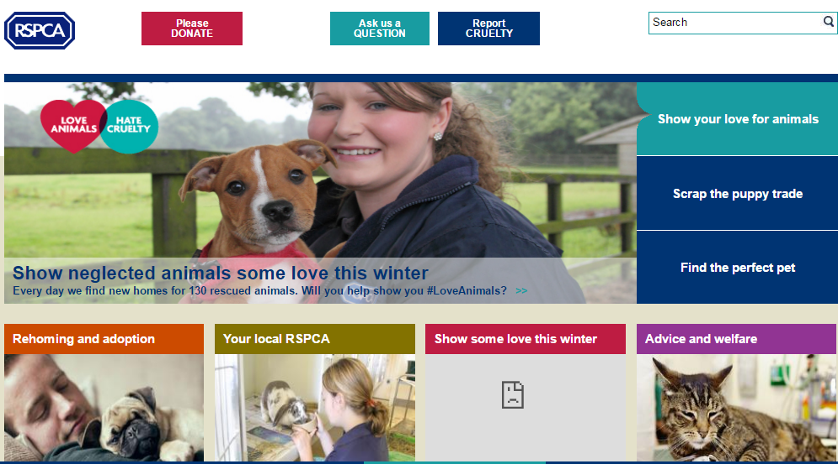
RSPCA – helping domestic animals find new homes as all animals need a good home.

Slide 6
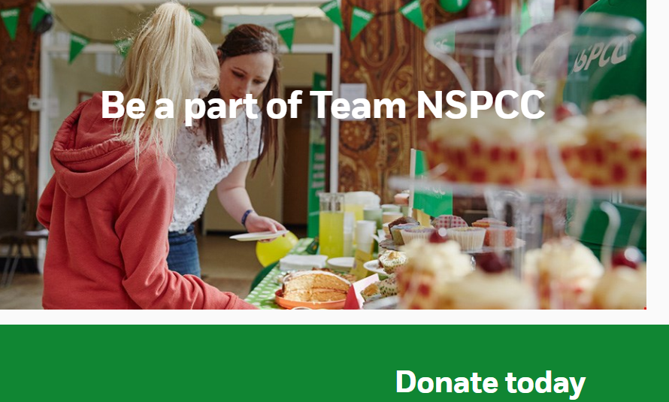
NSPCC – helping children who do not feel happy or safe as all children need to feel safe.

Slide 7
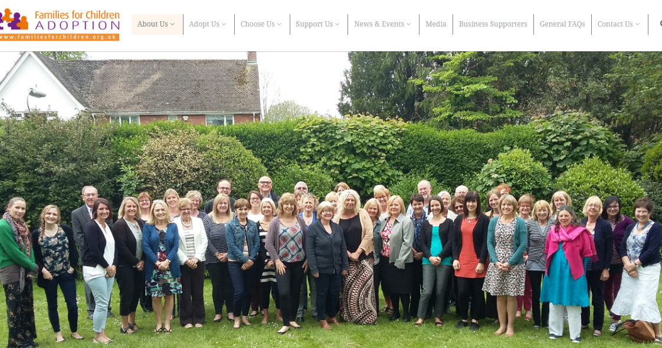
Adoption: helping children find new families to love them when they need one.

Slide 8
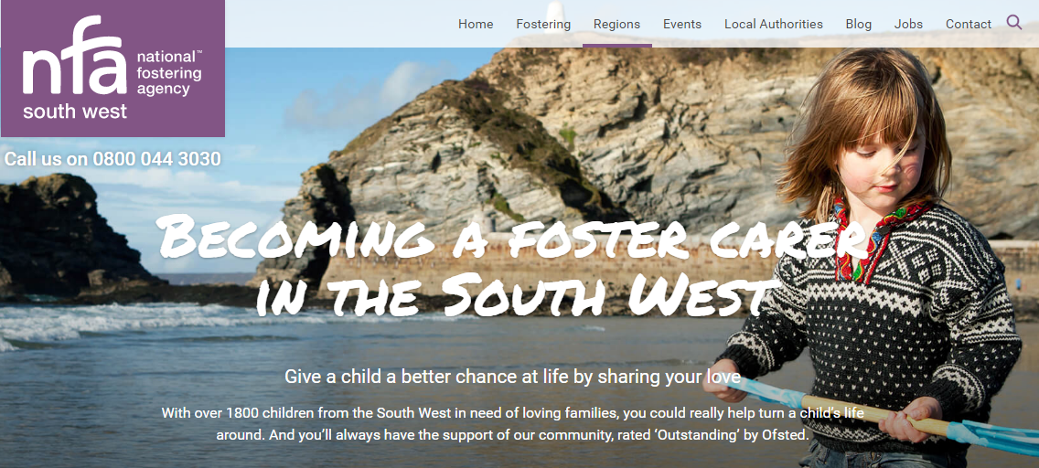
Fostering : helping a child to be safe in a loving home when they need help.

Slide 9

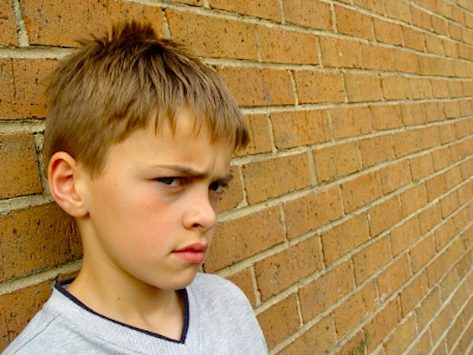
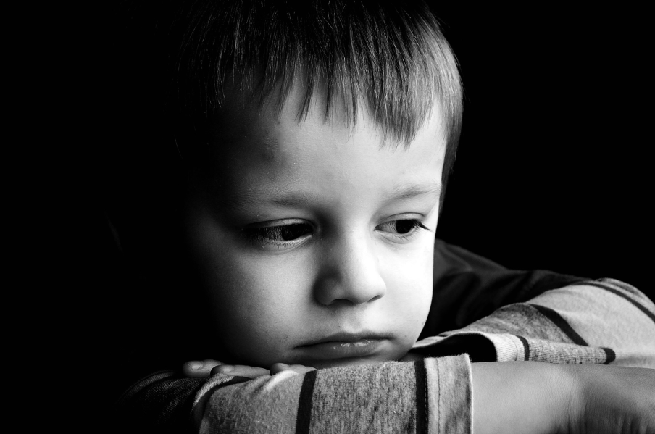
?
Sometimes we don’t know what is wrong or what the person needs….
So just be kind!

Slide 10
What would the
World Be like if
everyone had
Compassion?

