Slide 2
Keeping safe in the holidays
Playing in the playground
Playing at other people’s houses
Riding my bike outside
Not with my parent

Slide 3
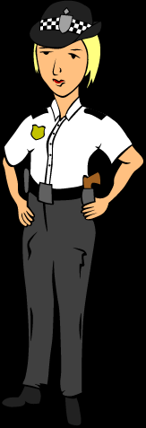
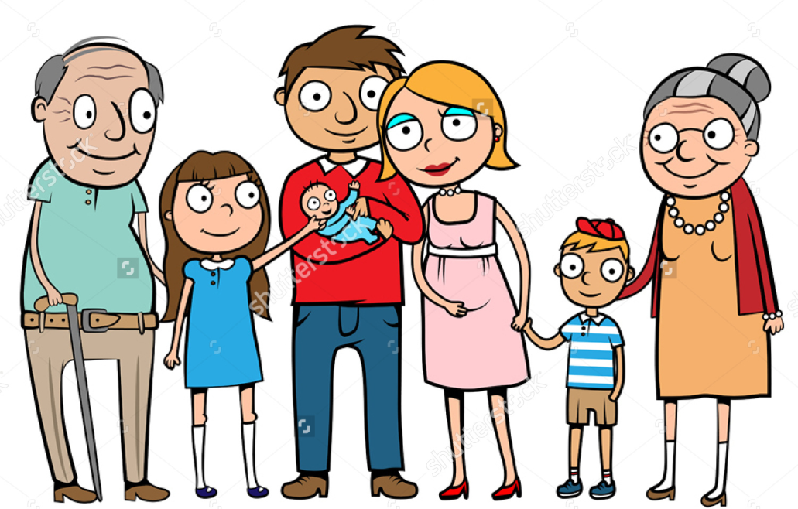
Who can keep me safe?
Parents
Grandparents
Neighbours
Police
Who else?

Slide 9
https://www.nspcc.org.uk/preventing-abuse/keeping-children-safe/underwear-rule/

Slide 10
Always…
Tell someone when you are worried
Tell someone when you are feeling unsafe
Tell someone if you are frightened
Always…
Tell someone how you feel!

