Slide 1
Being thankful
As my Mother used to say, “Manners cost nothing.”
However, sometimes we forget about the other things that we should be thankful for and our assembly today is hopefully going to highlight to you why we should be thankful a bit more often.

Slide 2
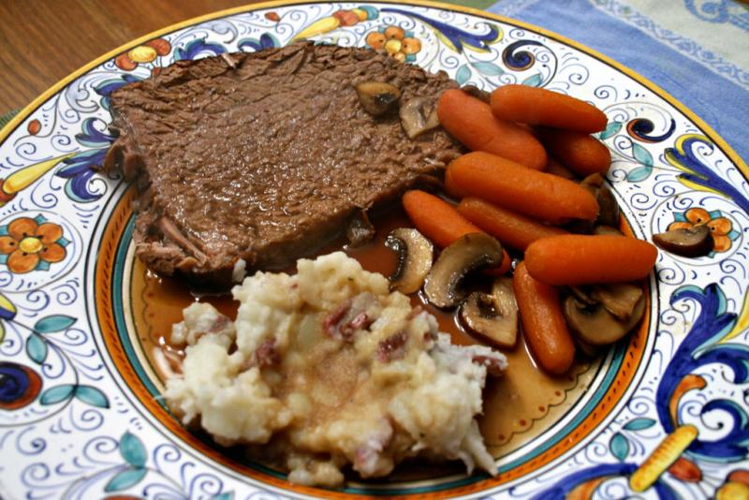

Slide 3
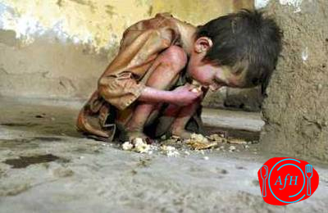

Slide 4
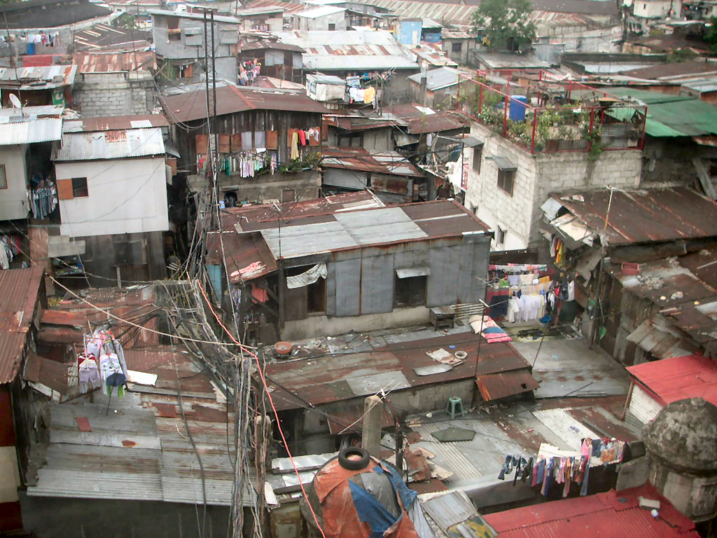

Slide 5
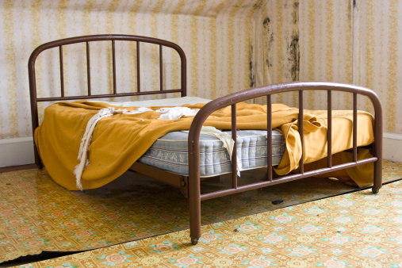

Slide 6
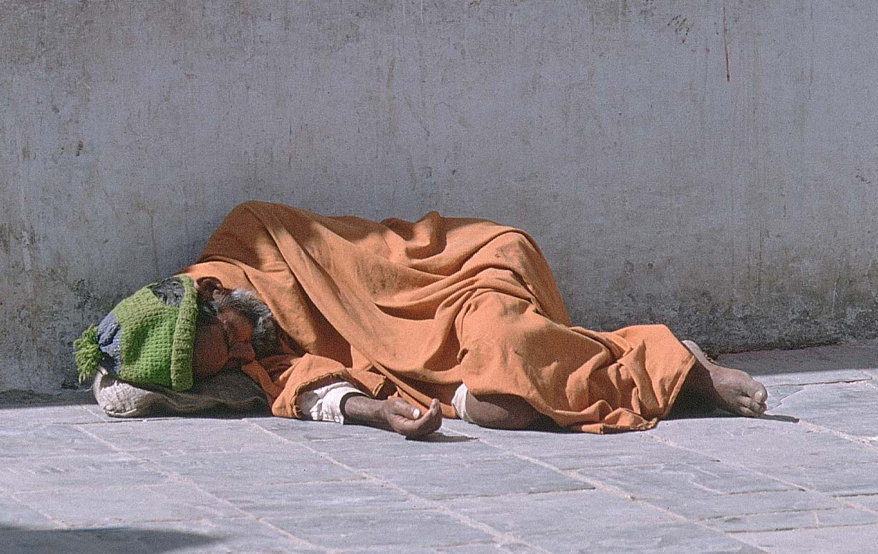

Slide 7
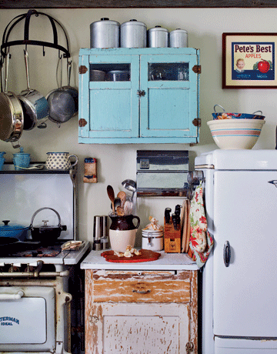

Slide 8
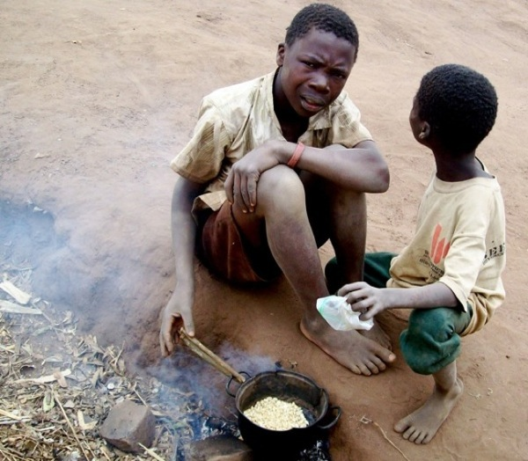

Slide 9
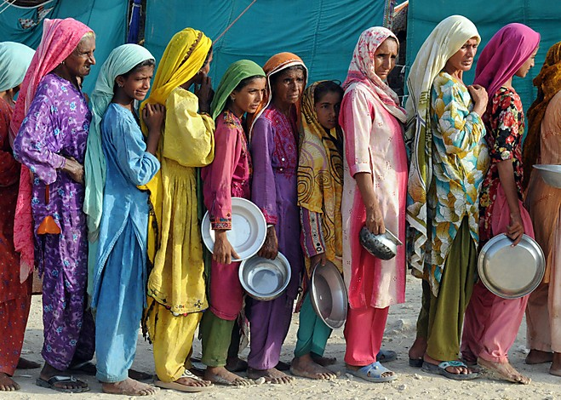

Slide 10
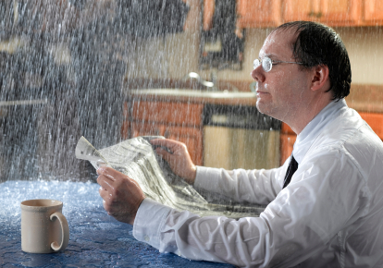

Slide 11
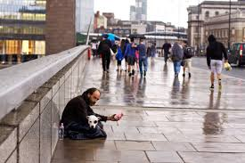

Slide 12
How often do we actually stop and appreciate what we have in life?
Sometimes it’s easy to feel bad because you’re going through a tough time in life. However, remember no matter how bad your situation may seem, there are tens of thousands of things to be grateful for in life, and there’s always somebody worse off than ourselves.

Slide 13
Prayer
God of Love, We thank you for the wonderful lives we lead,
We thank you for the people in our lives who are easy to love. We thank you for our family and friends who understand our actions, who support us in all the good things we do, and whose presence can cheer us up in darker times. Help us with those who are difficult to love. When they come at us with criticism; when they ignore us let us recognise their flaws and their dangers. But then let us remember your attitude towards them, and lead us to see them in the light of your love. Amen.

