Slide 1

The Compassionate Classroom
Why do I need one?
* behaviour, belonging, relationships….
What can I do to achieve one?
* play, explore, responsibility, challenge….
What can I achieve with one?
*everything I came into teaching for!
By Julie Norman
SOS

Slide 2
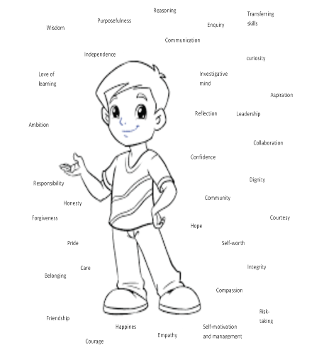
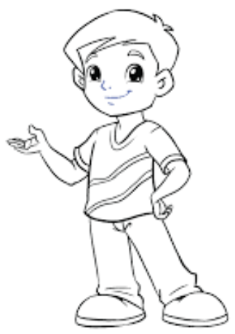
Meet Tom
He is 4 and about to start school.
He wants to know what you will do in your school to help him to be the best he can be, and help him to prepare for life!
He has dreams of who he wants to be in future…..

Slide 3
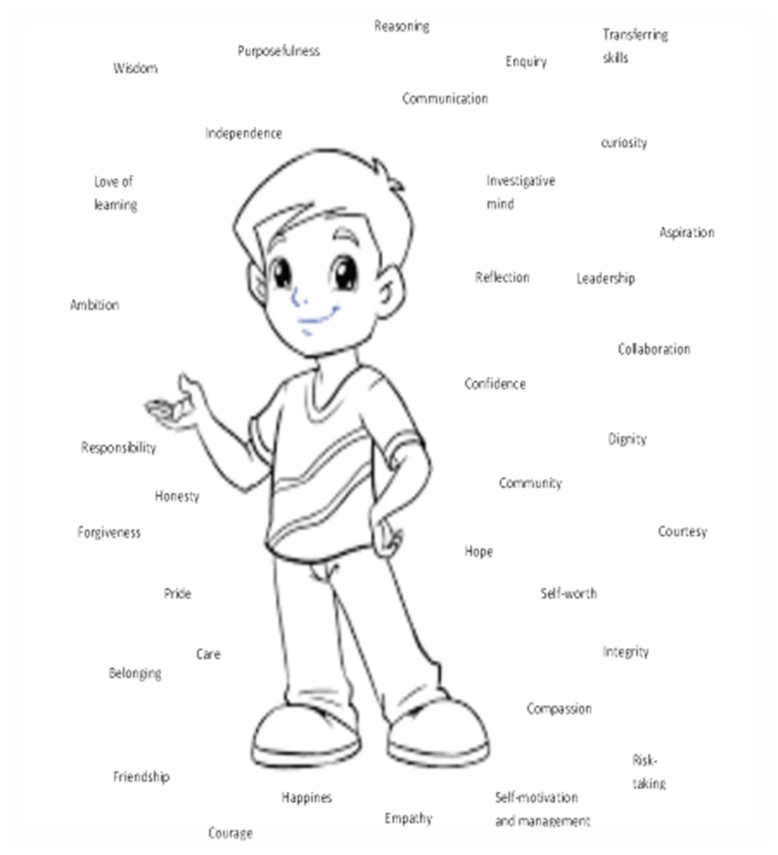
A sense of self
Social/emotional
Family
Relationships
Tom
A sense of others
Culture
Peers
Staff
A sense of the world
Curriculum

Slide 4
What do Compassionate Staff do?
Praise
Happy to see Tom
Smile at Tom
Wave to him
Thank him
Apologise to him
Nurture Tom
Be interested in what he says
Listen to him
Value his opinion
Talk about him
Check in on him
Celebrate Tom
Reassure him when he makes mistakes
Help him
Trust him
Maslow before Blooms!
What can compassisonate Parents do?
Unconditional love
Forgiveness
Know his gifts/talents
Understand him
Reassure him
Listen to him
Champion him
Praise him
Like him
Talk about him positively
Nurture him
Basic needs met
What can a compassionate classroom offer Tom?
Feeling loved
Feeling valued
Feeling cared for
Feeling liked
Feeling needed/wanted
What can peers offer in a compassionate classroom?
Loyalty, friendship, challenge, forgiveness, accountability, compromise, debate, equality, laughter, fun.

Slide 5
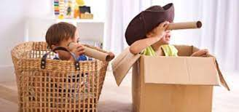
Language development
Acquiring skills
Character growth
Communication
Building good mental health
Gaining a Sense of self
A child’s right
Physical development
What is play?
Improving intelligence
Wellbeing & happiness
Brain development
Social development
Learning to regulate emotions
Meeting a Global goal

Slide 6

Social development Social competence Empathy Negotiations Cooperation Follow rules Self control Get along with others Sense of others | Relationships Trust Friendships Bonds Love Forgiveness Care Affection Compliments | Communication Body language learned Verbal language and meanings Reciprocate language practised Agreements Musical/singing Subtle and explicit shared | Brain development Cerebral cortex more developed leading to high cognitive ability and potential | Regulate emotions Self regulation – essential Resilience Co-regulate other children Helps to make and keep friends Can cope with disappointment
Language development Higher number of vocabulary acquired Higher tier of vocabulary being used Better understanding of words Better comprehension in context Leads to great readers and writers | Mental health Growth in resilience Positive outlook on life Better mindset when facing problems Can do attitude Comfortable asking for help | Improved intelligence Deeper level thinking – blooms taxonomy By 3 children who play have a higher IQ Problems solving as part of a group – high level of intelligence here practised daily | Sense of self Self belief in abilities Good knowledge of own strengths Good knowledge of own weaknesses Self worth and value Sense of adventure | Global goal It is now a Global goal that all children under 8 have the opportunity to learn through play
Skills Cognitive development Problem solving Rehearse life skills/problems Team innovation Higher concentration Out of the box thinking – blue sky Creative thinking – divergent thinking Better memory Good logic | Happiness and wellbeing Happy children! Well adjusted More cooperative Open to new ideas More popular A magnet to others Positive mindset More empathy Healthier overall | Character growth Listener Determination Resilience Confidence sense of self Team player Compassionate Has perspective - understanding Abstract thinker | Physical development Core strength Coordination Fine motor skills Gross motor skills Leading to good handwriting Stamina Strength/endurance | Rights of a child It is now the right of a child to have the opportunity to play
Take time to think of some children you know who don’t have these attributes…..
What have they been missing?

Slide 7
Why is it important?
Real life practise – a child mimics what they see and can learn how situations unfold, how characters in the play might feel and is independently creating a social story.
Inquiry based learning /active learning– a child can learn about their world around them, about themselves and about others through play by exploring, questioning and practising situations and behaviours.
Blue sky thinking – In play, there is no right or wrong, no inhibitions and no ceiling to what can happen.
Innovation and tomorrow’s entrepreneurs
Problem solving – where other children or adults join in, problems can be created and in a safe environment the child learns how to find a solution
Creative thinking – Anything is possible! You can be who you want in a world of your choice.
Character development – the child will create character traits they will want to explore which they have seen in others. It is a safe environment to see if they want to adopt the characteristic.
Physical – normally in play there is much movement, closeness, intimate at times which is good for happy hormones to swim around the body and keep us healthy

Slide 8

Happiness – play is designed to create a happy safe place, leading to happy children
Developing the brain – it builds IQ, deep thinking and higher concentration as well as empathy, self-control and a strong sense of self
Practising regulating emotions – emotions can be ‘played’ and ways to explore them and find ways to regulate them in a safe way
Social development – it takes two to tango and sometimes many more, leading to negotiation, cooperation and self control. This builds trusting relationships and allows the children to know what a friendship/relationship should feel like
A way to communicate – body language, subtle changes to the game, rules being set as well as explanations and feelings shared can help all children to communicate better
A way to collect vocabulary – every child brings thousands of words to the game, some made up and some from life experiences which are shared
Builds IQ – problems, conflict and creative thinking is proven to have raised the IQ of 3-year-olds
A sense of adventure – in play you can be anyone, anywhere experiencing anything!
Can you see why we do this from 0-5?

Slide 9
Relationships
Tom will only look for in life what he knows.
Staff:
Tom will learn how to be challenged by staff, learning they have faith in his abilities, growing in confidence;
Tom will learn he can be liked and loved by other people other than his family;
Tom will learn resilience as he learns, he will learn to try hard and accept failure as well as success;
Tom will learn how to learn, be curious about people and places realising the world is his oyster;
Tom will gain wisdom, responsibility, collaboration, independence, self belief, courage, self motivation, pride and a love of learning;
Tom will have the confidence to make informed and educated decisions in an emotionally safe environment.
Parents:
Tom will know there is always someone who loves him no matter how many mistakes he makes. He will discover and feel unconditional love;
Tom will have a safe and happy place to be when life gets tough;
Tom will learn about team work in the home and respecting those you live with;
Tom will learn to forgive and be forgiven to continue to live in harmony with those you love.
Peers:
Tom will learn to compromise, meet in the middle and share in order to have friends he trusts;
Tom will learn how to have trust in a relationship by building it from scratch;
Tom will learn how to treat others to gain their confidence, trust, support, loyalty and love;
Tom will learn to respect others if he wishes them to stay in his life and stay by his side.

Slide 10
I want a compassionate classroom……what can I do about it?
Sense of self:
Give Tom responsibilities
Give him Leadership opportunities, Self growth opportunities, Input into his learning
Give him time to share his ideas
Give him a voice in the school
Let him make changes
Give him chances to work on projects that have a huge impact in his community
Give him a chance to fail, followed up by reflection and celebration
Let Tom have the time to speak to others about his achievements – be an ambassador
Sense of others:
Give Tom a chance to help others as part of a team of ambassadors
Give him responsibilities around other people
Give him time to get to know others
Give him opportunities to support other people and celebrate his and their achievements
Help Tom to learn about the people around him
Help Tom to gain empathy and understanding of all events affecting others
Give Tom time to work on charity work
Let Tom be a mentor /coach
Sense of the world:
Let Tom participate in his learning journey by planning with you
Create a curriculum with projects he can help to plan and execute with real outcomes for the world
Help Tom to make the world a better place – reality and purpose
Teach Tom how to be a global citizen
Help Tom to be confident online and use it to communicate with the world
Help Tom carve his place in the world before he leaves school – know where his strengths are needed and valued

Slide 11
The Curriculum!
Whether you go for the Character Curriculum or Creative Curriculum or other – it is vital Tom is involved in the planning and delivery of it. Usually project based allows for real life purpose and sees the desired outcome being a real measured change in their community or the world that they can attribute their name to. Review if your curriculum meets your desired outcome (Intent). If not then instead of changing your intent, just change your curriculum!
Begin to share with the children the characteristics they may want to adopt and explicitly speak of them daily – celebrate where you see them.
Begin to allow the children to manage marketing and PR. They can write the articles they want to send out to the community to know about or draw them in to their cause as well as radio interviews.
The children to write the policies that affect them such as marking/feedback, curriculum policy, behaviour and many more.

Slide 12
Tom
Tom is leaving your school – it’s the end of Year 6!
He has all of these attributes simply due to a few changes you have made to how you treat him, include him, support him, challenge him, nurture him and allow him to have a voice.
He has a love of learning due to it being so purposeful and making a difference, thus bringing him confidence and joy. He has humility. He cares for others and knows he can help and make a difference in their lives, he saw this first hand in his work with you. He is a Global Citizen and knows about equality and difference. He values everyone.
He knows he is loved and liked.
When Tom looks for a partner or friends in life he will expect to be treated with respect, humility, care, love, compassion, forgiveness and dignity to name a few.
Anything less than that is alien to him.
Our job is to help Tom to be the best he can be, have high expectations of himself and others and be proactive in this world.
This is the best education you can give him!
www.schoolomegasolutions.co.uk

Slide 13
Recommended reading:
Oops by Hywel Roberts
The power of making thinking visible by Ritchhart and Church
The five side effects of kindness by David R Hamilton
Circle Solutions for student wellbeing by Sue Roffey
When the Adults change and After the adults change by Paul Dix
My Hidden Chimp by Prof Steve Peters

