Slide 1
Pupil Premium Conference by Julie Norman FCCT Primary Executive Leader & SOS Managing Director
Supporting Covid recovery work for Pupil Premium students: Responding to what we are seeing

Slide 2
Three main areas to consider today
Academic recovery | Emotional recovery | Social recovery
Coverage Understanding Misconceptions Gaps in learning Depth of learning | Being loved Having a champion Being celebrated Sense of self Belonging | Friendships Routines Rules Self regulation Formality
Some questions to start us off:
Which area has had the most discussion?
Which area has been on the news?
Which area has had the most money spent on it?
Which area might the children have been most negatively affected by missing out on?

Slide 3
Face to face Tutoring programme
ELSA for mental health issues
Lunchtime catch up
Key objectives
Extra teaching hours after school
What is covid recovery?
Academic recovery?
Catch up plan
Online Tutoring programme
Reading focus
Phonics x2 daily

Slide 4
Your turn!
Talk to the people around you
What have you used? What have schools in your area used?
Which one was most effective? Which one do YOU think would be most effective?

Slide 5
At Quantock Education Trust we carried out a pilot to see how effective the tutoring programme would be.
Here are our results: (with thanks to Gary Tucker at Stogursey Primary School)
FACE TO FACE | Good or better Progress
 | Pre | Post
All | 28% | 85%
Y1 | NA | NA
Y2 | 100% | 50%
Y3 | 16% | 83%
Y4 | 0% | 100%
Y5 | 25% | 100%
Y6 | NA | NA
PP | 0% | 100%
Non-PP | 36% | 81%
SEND | 40% | 80%
Virtual | Good or Better Progress
 | Pre | Post
All | 54% | 100%
Y1 | NA | NA
Y2 | NA | NA
Y3 | 0% | 100%
Y4 | NA | NA
Y5 | 100% | 100%
Y6 | 50% | 100%
PP | 66% | 100%
Non-PP | 36% | 100%
SEND | 50% | 100%

Slide 6
What did we find?
PP children achieved more with virtual tutoring
Tutoring helped UKS2 more (face to face and virtually)
Pupils with SEND filled in more gaps through the virtual programme than face-to-face.
When the children were given workbooks or online work they achieved far less
When they were given a person to encourage them and support with scaffolding they achieved far more
When they were in their safe home environment AND given a person to encourage them they achieved accelerated progress.
This brings me to my next area to consider – connections!

Slide 7
PLAY
friendship
Achievement
Physical touch
What else did children actually miss out on?
Emotional & Social recovery?
Whole school celebration
Having a champion
connections
Finding their sense of self
laughter

Slide 8
Your turn!
Talk to the people around you
What do you feel the children lost most from these? Which ones would have the highest impact on them ‘catching up’?

Slide 9
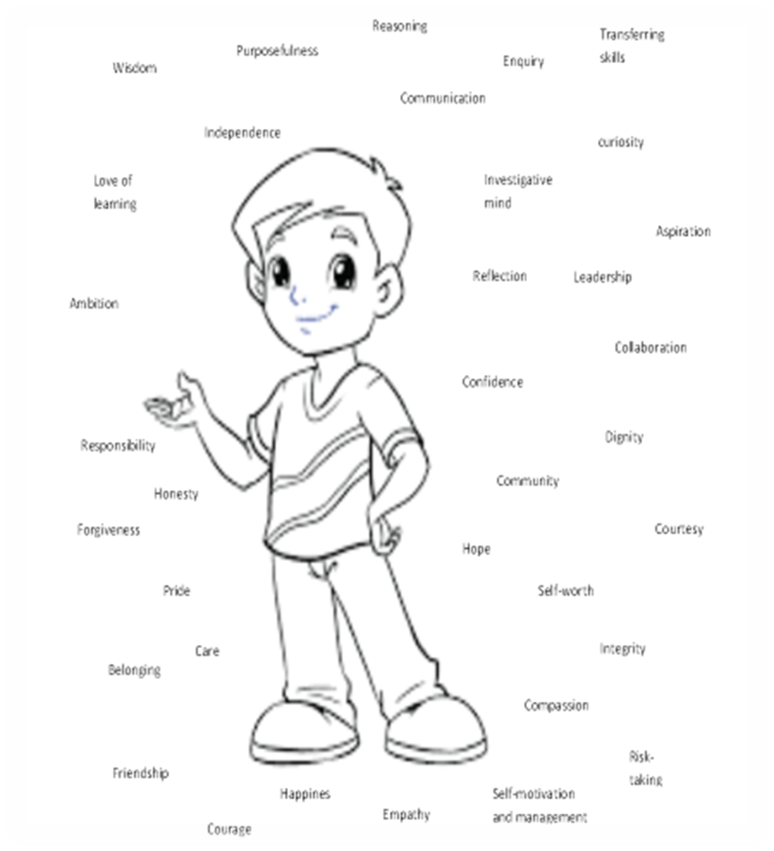
Multiple studies have shown that where relationships across schools are strong, the most disadvantaged pupils will thrive. (Marc Rowland)
A sense of self
Social/emotional
Family
Relationships
Child
A sense of others
Culture
Peers
Staff
A sense of the world
Curriculum
Taken from ‘The Compassionate Classroom’ by J.Norman

Slide 10
A powerful relationship looks like:
Sense of self:
Give them responsibilities
Give them Leadership opportunities, Self growth opportunities, Input into their learning
Give them time to share his ideas
Give them a voice in the school
Let them make changes
Give them chances to work on projects that have a huge impact in their community
Give them a chance to fail, followed up by reflection and celebration
Let them have the time to speak to others about their achievements – be an ambassador
Sense of others:
Give them a chance to help others as part of a team of ambassadors
Give them responsibilities around other people
Give them time to get to know others through play
Give them opportunities to support other people and celebrate their achievements
Help them to learn about the people around them
Help them to gain empathy and understanding of all events affecting others
Give them time to work on charity work
Let them be a mentor /coach
Sense of the world:
Let them participate in their learning journey by planning with you
Create a curriculum with projects they can help to plan and execute with real outcomes for the world
Help them to make the world a better place – reality and purpose
Teach them how to be global citizens
Help them to be confident online and use it to communicate with the world
Help them carve their place in the world before they leave school – know where their strengths are needed and valued

Slide 11
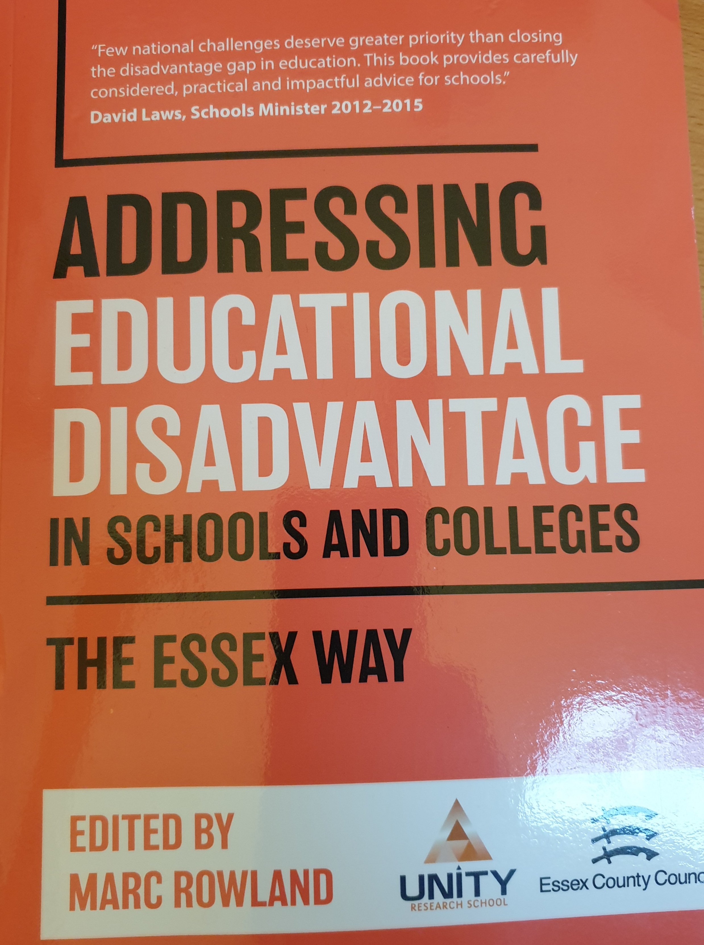
The Essex Way
Edited by Marc Rowland
‘One size cannot fit all … focus on the needs of the pupils, not labels!’
‘Multiple studies have shown that where relationships across schools are strong, the most disadvantaged pupils will thrive.’

Slide 12
Social development Social competence Empathy Negotiations Cooperation Follow rules Self control Get along with others Sense of others | Relationships Trust Friendships Bonds Love Forgiveness Care Affection Compliments | Communication Body language learned Verbal language and meanings Reciprocate language practised Agreements Musical/singing Subtle and explicit shared | Brain development Cerebral cortex more developed leading to high cognitive ability and potential | Regulate emotions Self regulation – essential Resilience Co-regulate other children Helps to make and keep friends Can cope with disappointment
Language development Higher number of vocabulary acquired Higher tier of vocabulary being used Better understanding of words Better comprehension in context Leads to great readers and writers | Mental health Growth in resilience Positive outlook on life Better mindset when facing problems Can do attitude Comfortable asking for help | Improved intelligence Deeper level thinking – blooms taxonomy children who play have a higher IQ Problems solving as part of a group – high level of intelligence here practised daily | Sense of self Self belief in abilities Good knowledge of own strengths Good knowledge of own weaknesses Self worth and value Sense of adventure | Global goal It is now a Global goal that all children under 8 have the opportunity to learn through play
Skills Cognitive development Problem solving Rehearse life skills/problems Team innovation Higher concentration Out of the box thinking – blue sky Creative thinking – divergent thinking Better memory Good logic | Happiness and wellbeing Happy children! Well adjusted More cooperative Open to new ideas More popular A magnet to others Positive mindset More empathy Healthier overall | Character growth Listener Determination Resilience Confidence sense of self Team player Compassionate Has perspective - understanding Abstract thinker | Physical development Core strength Coordination Fine motor skills Gross motor skills Leading to good handwriting Stamina Strength/endurance | Rights of a child It is now the right of a child to have the opportunity to play Take time to think of some children you know who don’t have these attributes….. What have they been missing?
Play!

Slide 13
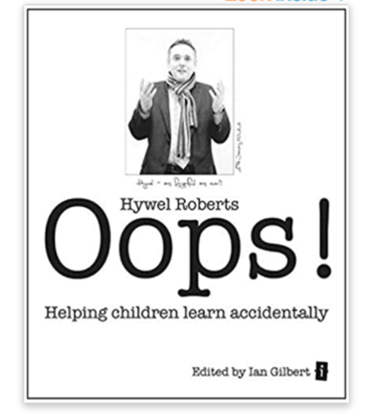
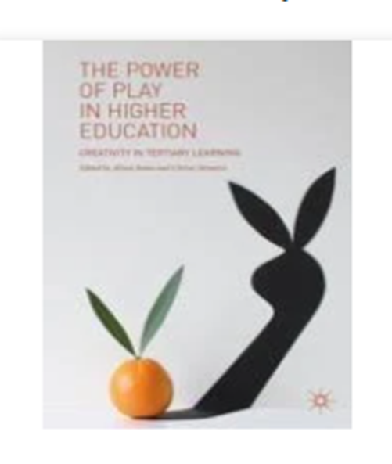
According to the Finnish educational expert Pasi Sahlberg, is “not to prepare children for school academically, but to make sure they are happy and responsible individuals”.
In short, writes Sahlberg, “Finland’s insight can boost grades and learning for all students, as well as their social growth, emotional development, health, wellbeing and happiness. It can be boiled down to a single phrase: let children play.”
The need is particularly urgent in schools reopening after pandemic lockdowns, he argued, since play will mitigate stress, promote resilience and allow children to rebuild relationships through physical activity: “They need that much more than they need academic pressure, graded assignments and excessive screen time.”
The Guardian 2021

Slide 14
Your turn!
Build a profile of a child you know who are PP, (include their family, experiences and home life) and list all the small things that would help them to ‘catch up’ academically, socially and emotionally.
Relational
Schools should connect with pupils and families on an individual basis in order to understand their context. This will inform teaching approaches, with emotional wellbeing at the heart of any approach.
(Marc Rowland)
Expectations
All schools and staff should have the highest expectations of all pupils, irrespective of background or barriers to learning.
(Marc Rowland)
Individualised
Disadvantaged pupils in our schools should not be treated as a homogenous group. Labels can create unconscious bias and set limitations on what pupils can achieve. Strategy and activity should always focus on pupil need.
(Marc Rowland)
Scaffold up – not differentiate down

Slide 15
The Essex Way, Edited by Marc Rowland
‘Assessment, not assumptions, should inform our strategy to address disadvantage on learning.’
‘Family – interactions, experiences, emotional literacy, attendance…what is family life like?’
‘Community culture - What disadvantage is in the community? what’s it like to grow up there?’
‘School – Best quality teachers, turnover of staff, support from governors. What’s it like to learn at your school?’

