Slide 1
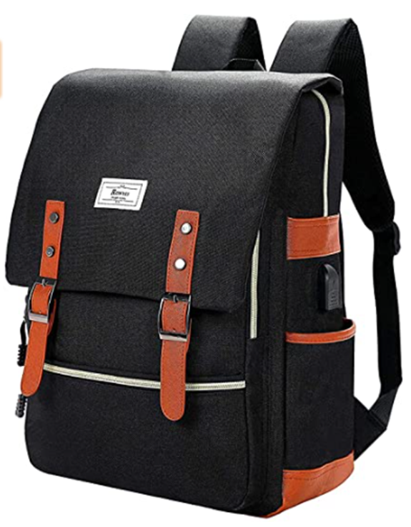

Early Career Teachers
Filling up your backpack!
By:
Julie Norman FCCT
School Omega Solutions
Executive Primary Lead

Slide 2
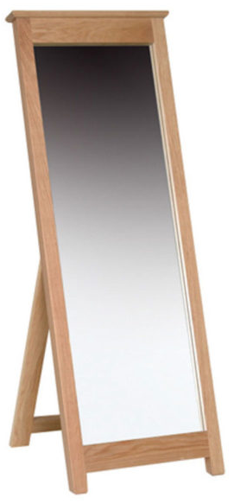
1. Behaviour management
Watch others!
Tone – when to be quiet, when to raise your voice, when to be gentle, happy, excited…etc. Set the tone with yours. The children will mirror you. Try it!
Language – do we assume they will do something? Do we fool them into doing what we want? Yes, we do.
Body language – what is your stance saying to the children?
Pace – think about literature. Short sharp sentences speed things up and create tension. Long sentences can set the scene. What will over excite them? What will bore them?

Slide 3
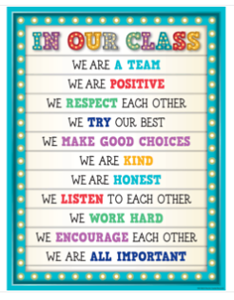
2. Expectations
Clear, concise and consistent
Classroom routines
Create routines that help the children to settle to work, carpet, tables, lines, lunch etc. Be consistent every single day, no matter what is going on. Soon they will do them without you even asking.
Behaviour routines
When you are consistent with behaviour expectations in the classroom incorporate them into the classroom routines
Environment
Are your walls supporting the pupils to meet the expectations? Prompts/pictures/rules/excellent work?

Slide 4

3. Relationships
What makes them happy?
Earn their trust and respect
Compassion, love and loco parentis
What makes them sad?
What is home like?
Connect with them
What stirs their emotions?
What lures them in?

Slide 5
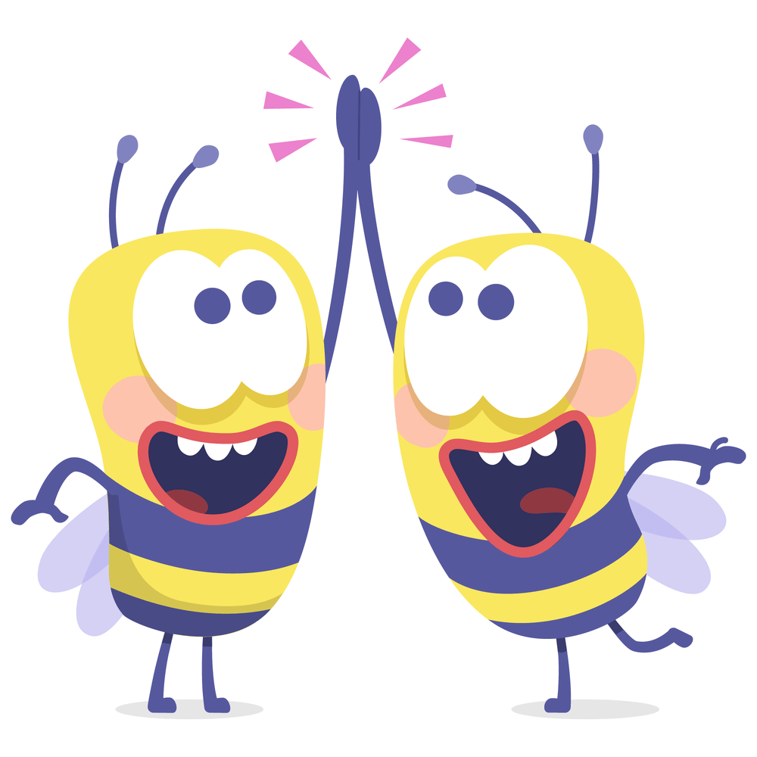
4. Your Support Staff
Friend, team, supporter and colleague
TA to all
Ensure your TA works with all of the children not just the low ability.
Team teach
Work collaboratively and team teach. Bounce off each other, have fun, create tension or humour.
Scaffold/question
Your TA is skilled in scaffolding learning, adapting for each child and can sharply question to probe for deeper understanding. They can observe, note, photograph, video or hold discussions with the pupil to feed into assessments. Use their skills.

Slide 6
5. Now the learning can begin
Facilitate learning, don’t tell!
questioning
outcome
Differentiation
By….
Model
Be vulnerable
task
scaffold
seesaw
video
Scaffolding
Questioning
photo
observe
Afl
Assessment for learning
question
mark
Hot task
Cold task
Go deep
Create explicit links

Slide 7
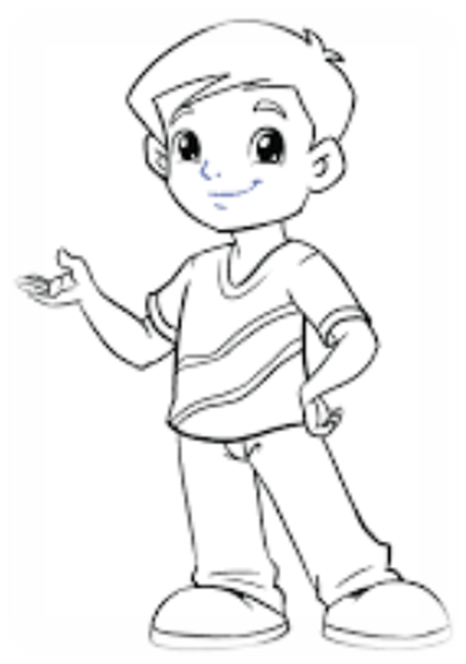
6. Building a learner
Future life-long learners
Curiosity
The children will be curious and ask questions when they feel it is safe – allowed to be wrong – model this. Class debates, discussions, pondering and wondering.
Play to their strengths
Do they know their strengths and weaknesses? Do they know others’ strengths? Do they use each others’ to work collaboratively? Do they inspire others and be inspired by other children in the classroom?
Metacognition
They need to learn how to learn, how to think, how to question and how to confidently share their thinking without judgement
Teach them to learn, not to know!

Slide 8
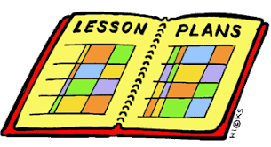

7. Planning
Short term planning
What do they already know?
What do you want them to know now?
What do they want to know?
What can they do with all that knowledge?
Get brave, get creative and nurture their thinking.
Long term planning
Phone a friend
Find a partner (even in another school!)
It’s all about coverage
Get the children involved
Don’t do it alone!

