Slide 1
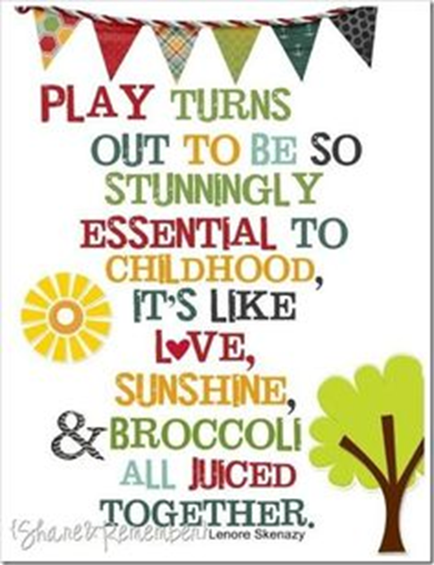
Julie Norman
Executive Primary Lead for Quantock Education Trust
and Director for Schools Omega Solutions
The power of imagination, creativity and play
Today we will look at :
What is play and why is it important?
Where does wellbeing come into this?
What age do we stop this expectation?

Slide 2
What is play?

Slide 3
Language development
Acquiring skills
Character growth
Communication
Building good mental health
Gaining a Sense of self
A child’s right
Physical development
What is play?
Improving intelligence
Wellbeing & happiness
Brain development
Social development
Learning to regulate emotions
Meeting a Global goal

Slide 4
Social development Social competence Empathy Negotiations Cooperation Follow rules Self control Get along with others Sense of others | Relationships Trust Friendships Bonds Love Forgiveness Care Affection Compliments | Communication Body language learned Verbal language and meanings Reciprocate language practised Agreements Musical/singing Subtle and explicit shared | Brain development Cerebral cortex more developed leading to high cognitive ability and potential | Regulate emotions Self regulation – essential Resilience Co-regulate other children Helps to make and keep friends Can cope with disappointment
Language development Higher number of vocabulary acquired Higher tier of vocabulary being used Better understanding of words Better comprehension in context Leads to great readers and writers | Mental health Growth in resilience Positive outlook on life Better mindset when facing problems Can do attitude Comfortable asking for help | Improved intelligence Deeper level thinking – blooms taxonomy By 3 children who play have a higher IQ Problems solving as part of a group – high level of intelligence here practised daily | Sense of self Self belief in abilities Good knowledge of own strengths Good knowledge of own weaknesses Self worth and value Sense of adventure | Global goal It is now a Global goal that all children under 8 have the opportunity to learn through play
Skills Cognitive development Problem solving Rehearse life skills/problems Team innovation Higher concentration Out of the box thinking – blue sky Creative thinking – divergent thinking Better memory Good logic | Happiness and wellbeing Happy children! Well adjusted More cooperative Open to new ideas More popular A magnet to others Positive mindset More empathy Healthier overall | Character growth Listener Determination Resilience Confidence sense of self Team player Compassionate Has perspective - understanding Abstract thinker | Physical development Core strength Coordination Fine motor skills Gross motor skills Leading to good handwriting Stamina Strength/endurance | Rights of a child It is now the right of a child to have the opportunity to play
Take time to think of some children you know who don’t have these attributes…..
What have they been missing?

Slide 5
Why is it important?
Real life practise – a child mimics what they see and can learn how situations unfold, how characters in the play might feel and is independently creating a social story.
Inquiry based learning /active learning– a child can learn about their world around them, about themselves and about others through play by exploring, questioning and practising situations and behaviours.
Blue sky thinking – In play, there is no right or wrong, no inhibitions and no ceiling to what can happen.
Innovation and tomorrow’s entrepreneurs
Problem solving – where other children or adults join in, problems can be created and in a safe environment the child learns how to find a solution
Creative thinking – Anything is possible! You can be who you want in a world of your choice.
Character development – the child will create character traits they will want to explore which they have seen in others. It is a safe environment to see if they want to adopt the characteristic.
Physical – normally in play there is much movement, closeness, intimate at times which is good for happy hormones to swim around the body and keep us healthy

Slide 6
Happiness – play is designed to create a happy safe place, leading to happy children
Developing the brain – it builds IQ, deep thinking and higher concentration as well as empathy, self-control and a strong sense of self
Practising regulating emotions – emotions can be ‘played’ and ways to explore them and find ways to regulate them in a safe way
Social development – it takes two to tango and sometimes many more, leading to negotiation, cooperation and self control. This builds trusting relationships and allows the children to know what a friendship/relationship should feel like
A way to communicate – body language, subtle changes to the game, rules being set as well as explanations and feelings shared can help all children to communicate better
A way to collect vocabulary – every child brings thousands of words to the game, some made up and some from life experiences which are shared
Builds IQ – problems, conflict and creative thinking is proven to have raised the IQ of 3 year olds
A sense of adventure – in play you can be anyone, anywhere experiencing anything!
Can you see why we do this from 0-5?

Slide 7
What’s that got to do with wellbeing?
Staff
Praise
Happy to see child
Smile at child often
Wave to child
Thank them
Apologise to them
Nurture child
Be interested in what they say
Listen to them
Value their opinion
Talk about them positively
Check in on them
Celebrate them
Reassure them when they make mistakes
Help them
Trust them
Maslow before Blooms!
Parents
Unconditional love
Forgiveness
Know their gifts/talents
Understand them
Reassure them
Listen to them
Champion them
Praise them
Like them
Talk about them positively
Nurture them
Basic needs met
Relationships are formed leading to:
Feeling needed/wanted
Feeling cared for
Feeling valued
Feeling loved
Feeling liked
Peers
Loyalty, friendship, challenge, forgiveness, accountability, compromise, debate, equality, laughter, fun.

Slide 8
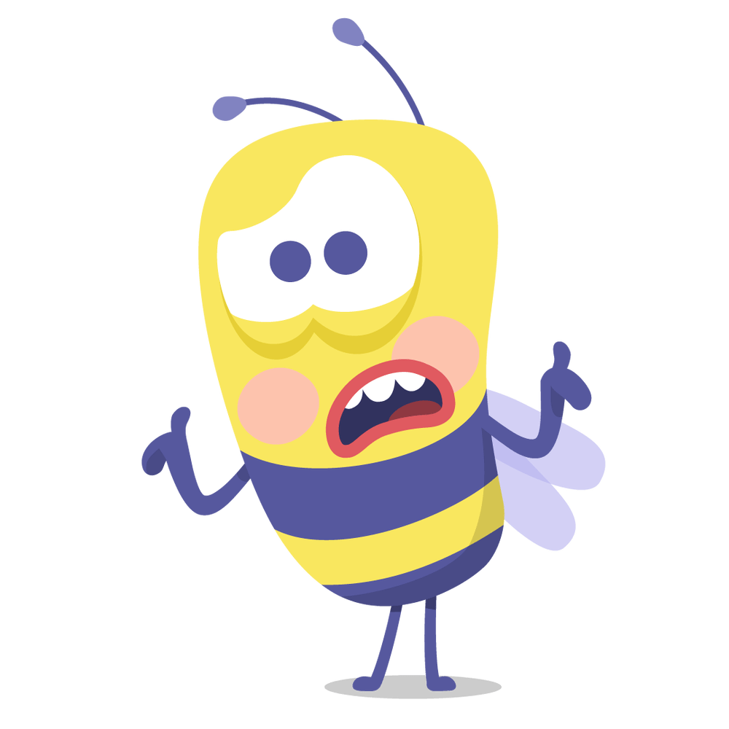
When do we stop teaching through play?
With all those benefits….
why would you want to?

Slide 9
From Early Years to Primary to adulthood…

Slide 10
References:
https://www.unicef.org/sites/default/files/2018-12/UNICEF-Lego-Foundation-Learning-through-Play.pdf
https://www.parentingforbrain.com/benefits-play-learning-activities-early-childhood/
https://www.familylives.org.uk/advice/early-years-development/learning-and-play/why-play-matters
https://pediatrics.aappublications.org/content/119/1/182
https://www.teachthought.com/learning/innovation-imagination-12-benefits-creativity/
https://academy.schooleducationgateway.eu/documents/1508261/0/power+of+play/ec599a0c-c9e5-405d-9c0c-c65872fe1e21

