Slide 1

Julie Norman
Executive Primary Lead for Quantock Education Trust
and Director for Schools Omega Solutions
Relationships Education: Embedding the mental health & wellbeing elements across the school
What is Wellbeing?
This workshop will look at what we consider to be ‘wellbeing’, how to achieve good mental health for children but also how these can be achieved through meaningful relationships in school along with a few changes to our curriculum, culture and ethos.
What impact can it have?
A child who is loved, cared for, valued and nurtured are confident, happy and resilient. Happy children grow into happy adults, confident resilient children grow into successful adults who are ambitious and driven. Children who are happy and driven are less likely to suffer poor mental health.
What can I do about it?
We will look at a few ideas to help nurture their purpose in school, self-care, belonging, lifestyle and relationships with their school community as well as their curriculum.
What is the desired outcome?
A child will only look for in life what they know.
Nurturing a child’s welling, mental health and healthy relationships comes from small but vital behaviours in school which I will offer you lots of ideas, what we did at my schools, but also how your curriculum, ethos and culture will achieve so much more than you ever thought possible.

Slide 2
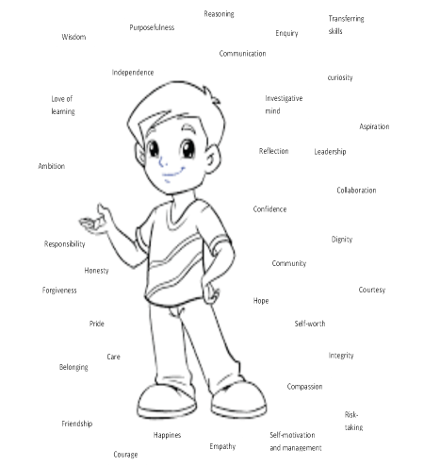
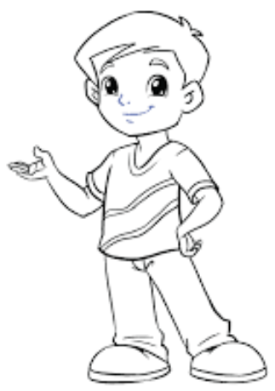

Meet Tom
He is 4 and about to start school.
He wants to know what you will do in your school to help him to be the best he can be, get a great job in 2045 and help him to prepare for life!
He has dreams of who he wants to be in future…..

Slide 3
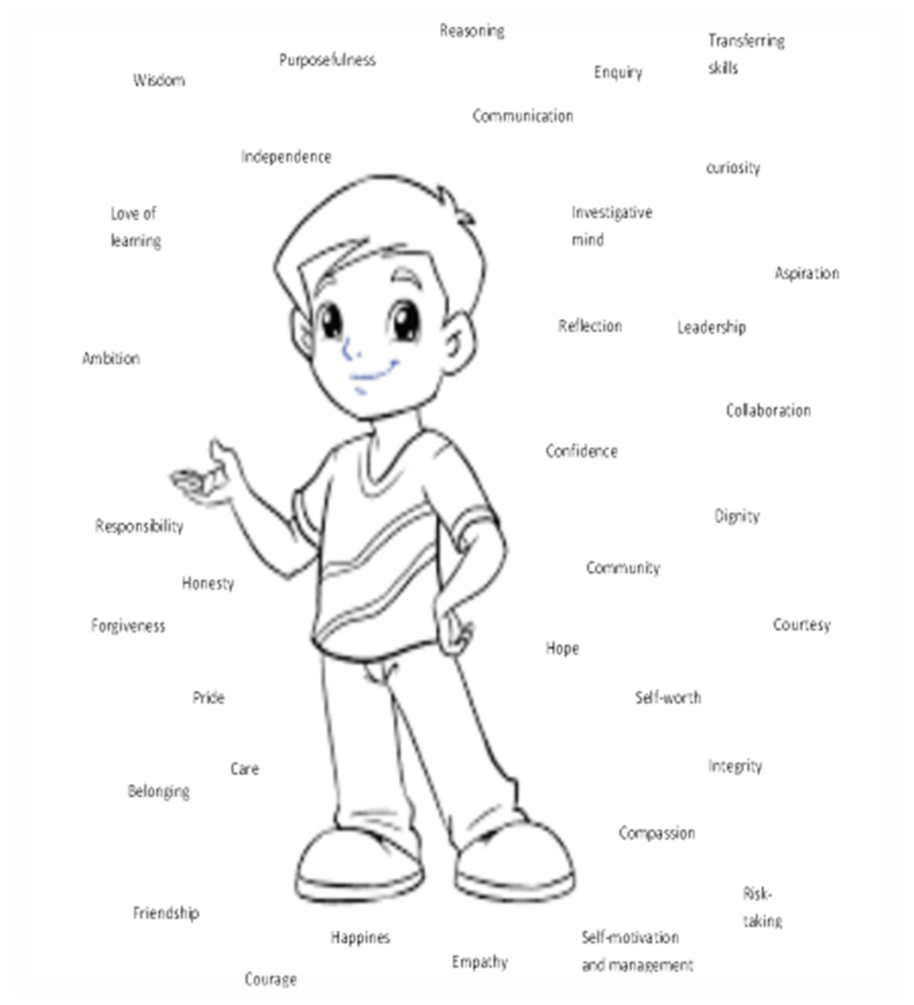
Social/emotional
A sense of self
Family
Relationships
Tom
Culture
A sense of others
Peers
Staff
Curriculum
A sense of the world

Slide 4
Tom
Staff
Praise
Happy to see Tom
Smile at Tom
Wave to him
Thank him
Apologise to him
Nurture Tom
Be interested in what he says
Listen to him
Value his opinion
Talk about him
Check in on him
Celebrate Tom
Reassure him when he makes mistakes
Help him
Trust him
Maslow before Blooms!
Parents
Unconditional love
Forgiveness
Know his gifts/talents
Understand him
Reassure him
Listen to him
Champion him
Praise him
Like him
Talk about him positively
Nurture him
Basic needs met
What is Wellbeing?
Feeling loved
Feeling valued
Feeling cared for
Feeling liked
Feeling needed/wanted
Peers
Loyalty, friendship, challenge, forgiveness, accountability, compromise, debate, equality, laughter, fun.

Slide 5
Relationships
Tom will only look for in life what he knows.
Staff:
Tom will learn how to be challenged by staff, learning they have faith in his abilities, growing in confidence;
Tom will learn he can be liked and loved by other people other than his family;
Tom will learn resilience as he learns, he will learn to try hard and accept failure as well as success;
Tom will learn how to learn, be curious about people and places realising the world is his oyster;
Tom will gain wisdom, responsibility, collaboration, independence, self belief, courage, self motivation, pride and a love of learning;
Tom will have the confidence to make informed and educated decisions in an emotionally safe environment.
Parents:
Tom will know there is always someone who loves him no matter how many mistakes he makes. He will discover and feel unconditional love;
Tom will have a safe and happy place to be when life gets tough;
Tom will learn about team work in the home and respecting those you live with;
Tom will learn to forgive and be forgiven to continue to live in harmony with those you love.
Peers:
Tom will learn to compromise, meet in the middle and share in order to have friends he trusts;
Tom will learn how to have trust in a relationship by building it from scratch;
Tom will learn how to treat others to gain their confidence, trust, support, loyalty and love;
Tom will learn to respect others if he wishes them to stay in his life and stay by his side.

Slide 6
What can I do about it?
Sense of self:
Give Tom responsibilities
Give him Leadership opportunities, Self growth opportunities, Input into his learning
Give him time to share his ideas
Give him a voice in the school
Let him make changes
Give him chances to work on projects that have a huge impact in his community
Give him a chance to fail, followed up by reflection and celebration
Let Tom have the time to speak to others about his achievements – be an ambassador
Sense of others:
Give Tom a chance to help others as part of a team of ambassadors
Give him responsibilities around other people
Give him time to get to know others
Give him opportunities to support other people and celebrate his and their achievements
Help Tom to learn about the people around him
Help Tom to gain empathy and understanding of all events affecting others
Give Tom time to work on charity work
Let Tom be a mentor /coach
Sense of the world:
Let Tom participate in his learning journey by planning with you
Create a curriculum with projects he can help to plan and execute with real outcomes for the world
Help Tom to make the world a better place – reality and purpose
Teach Tom how to be a global citizen
Help Tom to be confident online and use it to communicate with the world
Help Tom carve his place in the world before he leaves school – know where his strengths are needed and valued

Slide 7
The Curriculum redesign!
Whether you go for the Character Curriculum or Creative Curriculum or other – it is vital Tom is involved in the planning and delivery of it. Usually project based allows for real life purpose and sees the desired outcome being a real measured change in their community or the world that they can attribute their name to. Review if your curriculum meets your desired outcome (Intent). If not then instead of changing your intent, just change your curriculum!
Begin to share with the children the characteristics they may want to adopt and explicitly speak of them daily – celebrate where you see them.
Begin to allow the children to manage marketing and PR. They can write the articles they want to send out to the community to know about or draw them in to their cause as well as radio interviews.
The children to write the policies that affect them such as marking/feedback, curriculum policy, behaviour and many more.

Slide 8
Tom
Tom is leaving your school – it’s the end of Year 6!
He has all of these attributes simply due to a few changes you have made to how you treat him, include him, support him, challenge him, nurture him and allow him to have a voice.
He has a love of learning due to it being so purposeful and making a difference, thus bringing him confidence and joy. He has humility. He cares for others and knows he can help and make a difference in their lives, he saw this first hand in his work with you. He is a Global Citizen and knows about equality and difference. He values everyone.
He knows he is loved and liked.
When Tom looks for a partner or friends in life he will expect to be treated with respect, humility, care, love, compassion, forgiveness and dignity to name a few.
Anything less than that is alien to him.
Our job is to help Tom to be the best he can be, have high expectations of himself and others and be proactive in this world.
This is the best education you can give him!
www.schoolomegasolutions.co.uk

