Slide 1
Julie Norman
Executive Primary Lead for Quantock Education Trust
and Director for Schools Omega Solutions
Workshop Title:
Relationships Education: Embedding the mental health & wellbeing elements across the school
What is Wellbeing?
This workshop will look at what we consider to be ‘wellbeing’, how to achieve good mental health for children but also how these can be achieved through meaningful relationships in school along with a few changes to our curriculum, culture and ethos.
What impact can it have?
A child who is loved, cared for, valued and nurtured are confident, happy and resilient. Happy children grow into happy adults, confident resilient children grow into successful adults who are ambitious and driven. Children who are happy and driven are less likely to suffer poor mental health.
What can I do about it?
We will look at a few ideas to help nurture their purpose in school, self-care, belonging, lifestyle and relationships with their school community as well as their curriculum.
What is the desired outcome?
A child will only look for in life what they know.
Nurturing a child’s welling, mental health and healthy relationships comes from small but vital behaviours in school which I will offer you lots of ideas, what we did at my schools, but also how your curriculum, ethos and culture will achieve so much more than you ever thought possible.

Slide 2
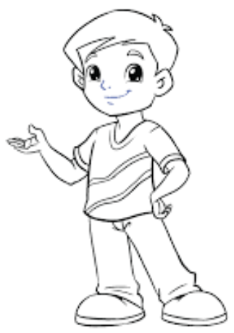
Meet Tom
He is 4 and about to start school.
He wants to know what you will do in your school to help him to be the best he can be, get a great job in 2045 and help him to prepare for life!
He has dreams of who he wants to be in future…..

Slide 3
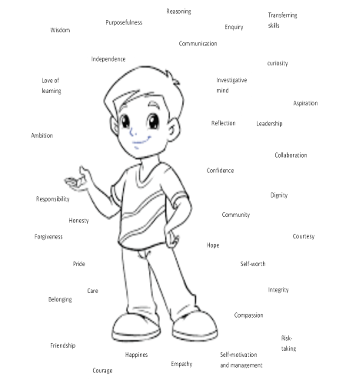

Slide 4
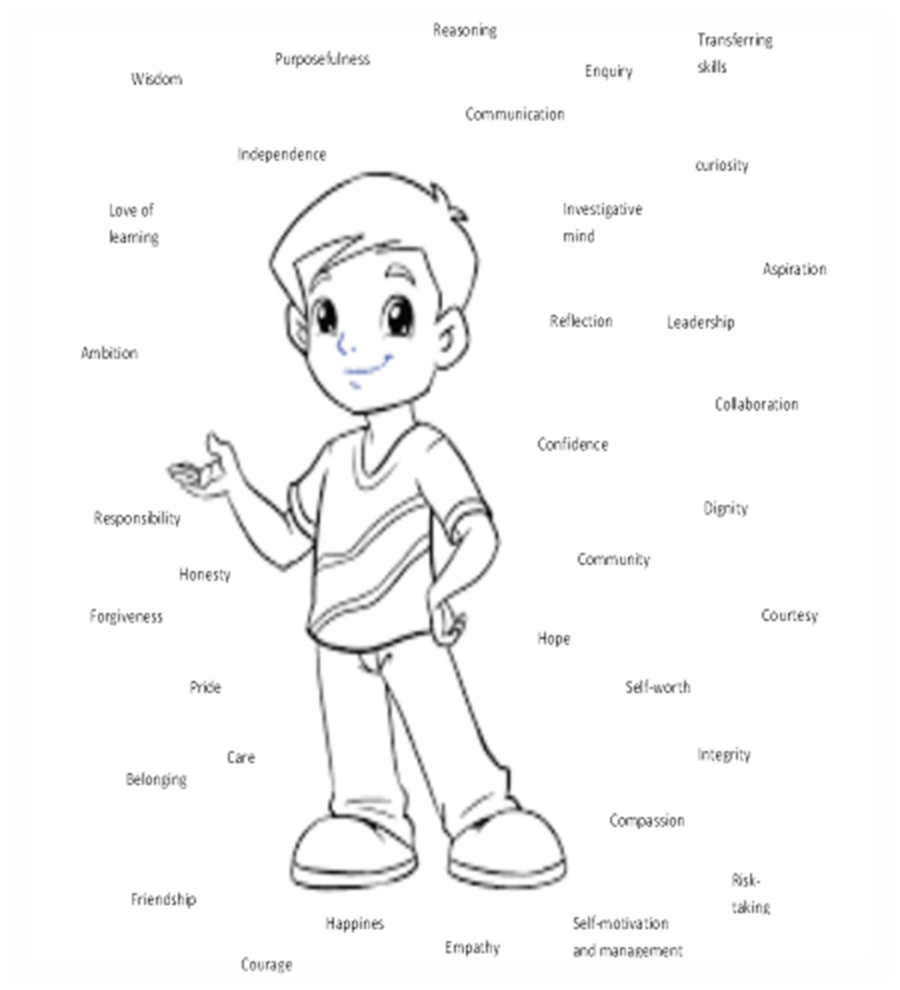
Social/emotional
A sense of self
Family
Relationships
Tom
Culture
A sense of others
Peers
Curriculum
A sense of the world
Staff

