Slide 1
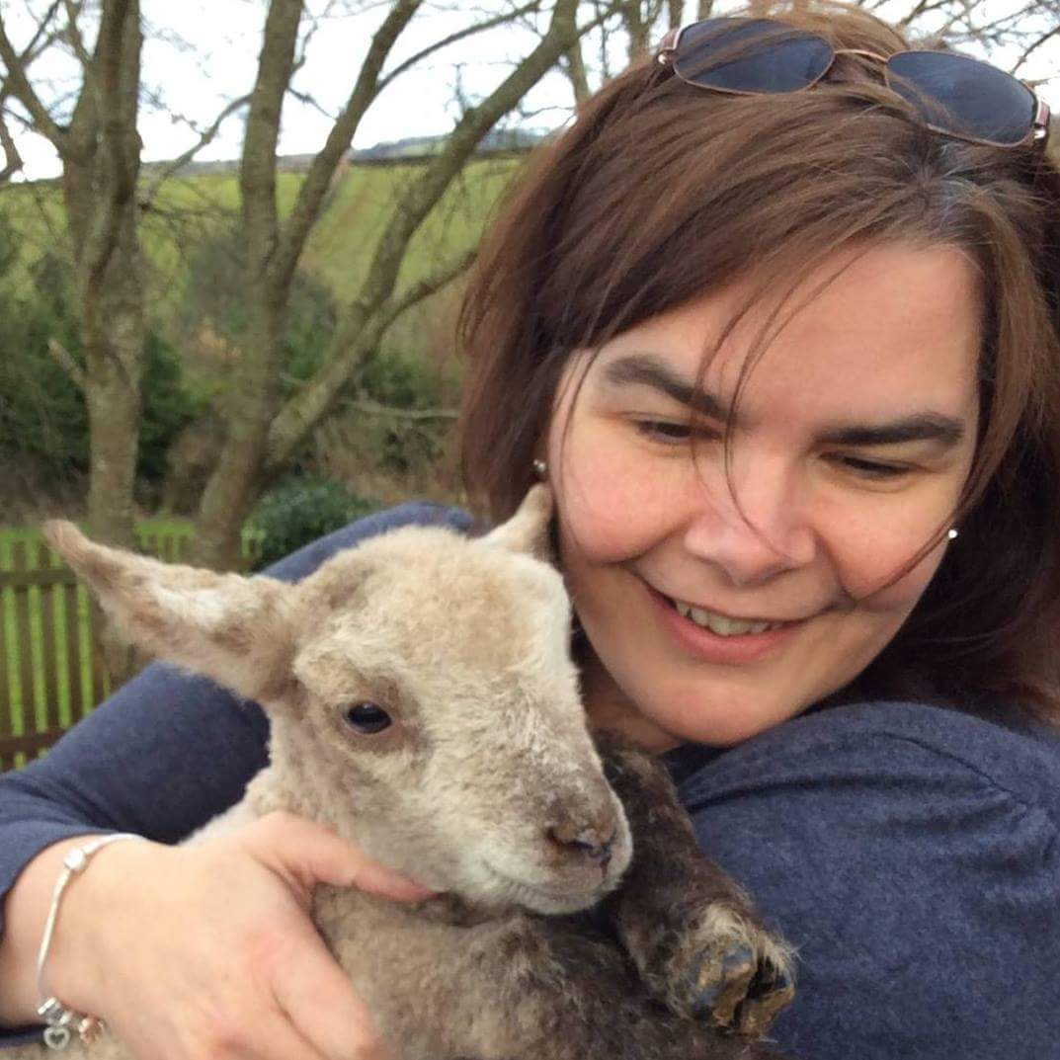
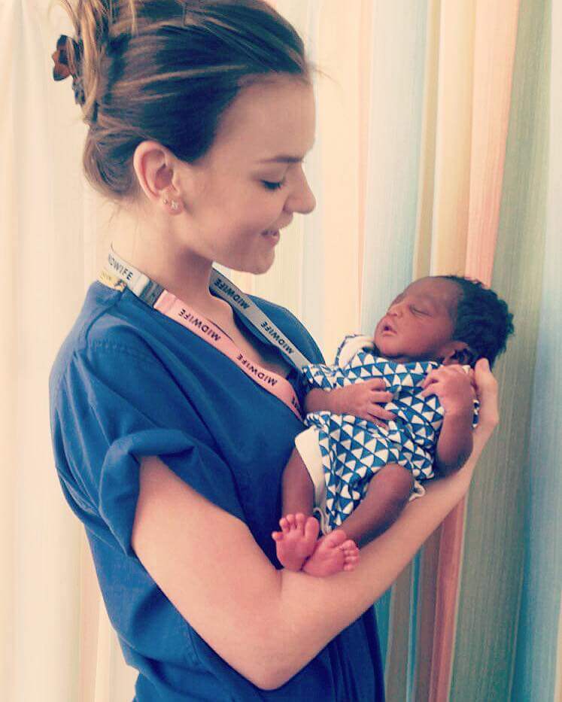
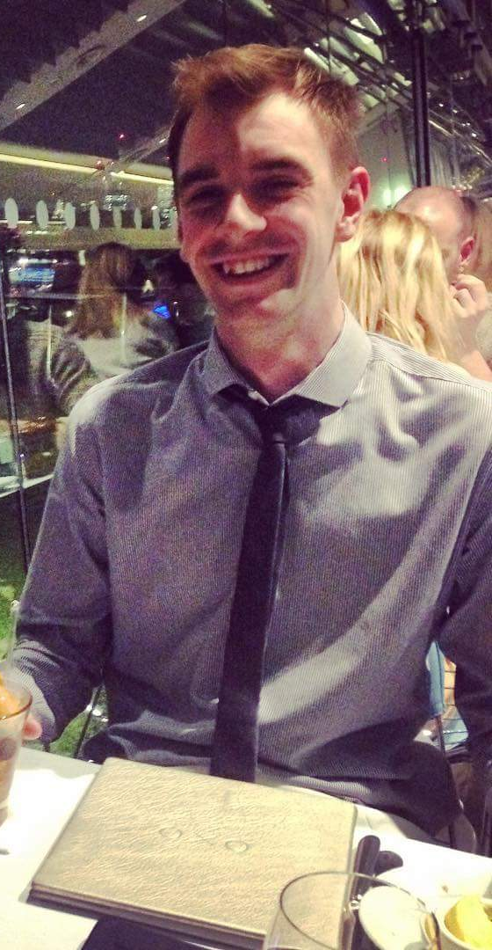
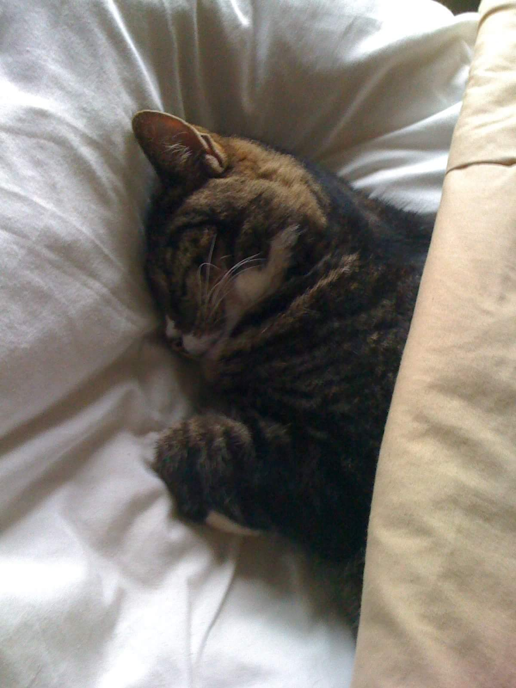
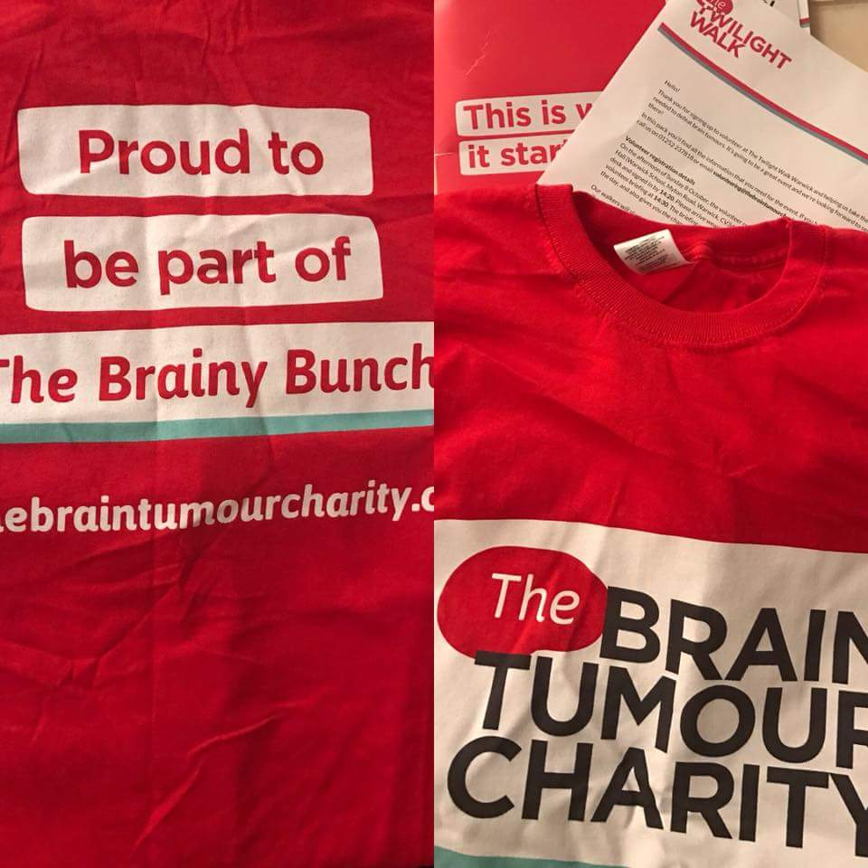
Julie Norman
BA(Hons) PGCE NPQH NPQEL
Director for Schools Omega Solutions
All about me!

Slide 2
My Story:
Growing up
UK school
Relationships
Ambition
#areyouok
Notes:
Ireland – nanny, priest, school
IRA – excluded from society and school
No mother around, angry step father brothers left violent boyfriend
At 28 ran away! Started a new life.
All I wanted was someone to ask are you ok?
Worked with the unteachables for 6 years – BHMS / Turlin Moor
SENDCo and Trauma Informed

Slide 3
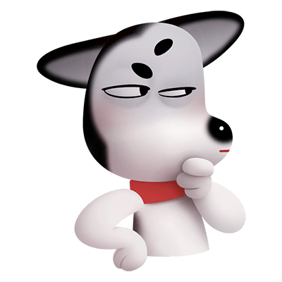
Today we will look at : What makes a school great? Learn about ourselves Control your Chimp, to control theirs! Strategies to help

Slide 4
Activity
Notes:
On a sticky, one thing you would never have known about me before (list something no on would know) (shy etc)
Share some of these and see if you really know each other as well as you think you do!
People have layers
People have pasts
People have parts of their lives they don’t want to share
People have triggers!

Slide 5
Knowing what sets you on edge and brings the worst out in you
Knowing your colleague’s strengths and weaknesses
Knowing your own strengths and weaknesses
Knowing what is uncomfortable for your colleagues and puts them on edge
Appreciating what is special about your colleagues and yourself
What makes a school great? YOU!
Knowing what is expected of you all of the time
Working together in harmony
Feeling valued as a member of staff
All staff using their talents everyday and nurtured

Slide 6
Activity
My 3 key strengths
What puts me outside my comfort zone
Notes:
Each person puts on a sticky note 3 things they are good at in school
On another sticky, put one thing that puts you outside your comfort zone in school (subject, responsibility, teaching style)
When finished – put down strengths you see in someone else they did not put about themselves

Slide 7
I need support
I need policies
This Photo by Unknown Author is licensed under CC BY-SA
I need strategies
Notes:
To feel valued, calm and in control, what do you need?
What do you need to carry out your responsibilities?
What do you need to carry out the expectations set on you?

Slide 8
Activity
Write down a time when you were asked to do something that you really did not want to do. Either you hated it, it went against your principles or you were not equipped with the skills | What was your first thought/ feeling | How did you react? | What did you want someone to do to help at that moment? What could they have done? | How do you feel about the whole scenario when you look back on it?
Write down a time when you were frightened, petrified, stage fright etc | What were your first instincts? | What did you do? | What could someone have done to help in that moment? | Looking back, what are your thoughts?
Write down a time when you were stressed, too much going on leading to feeling overwhelmed. When there was more than you could cope with, yet it continued coming in… | What were your thoughts? Feelings? | How did you react? | What could someone have done to help you? | Looking back, what are your thoughts?
Notes:
The feelings and thoughts are what your children have
What you wanted someone to do they want you to do
Hindsight from your own experiences should tell you what you need to do for the child

Slide 9
How useful has it been to consider your strengths, weaknesses, triggers, needs and thoughts/feelings?
Let’s go back and consider doing these exercises with the children!
We are all the same –
Chimps!

Slide 10
Logical vs Chimp
The logical brain uses evidence only to make decisions
The chimp relies on the logical brain to tell it what to do, if there is no information from logical brain, then it panics

Slide 11
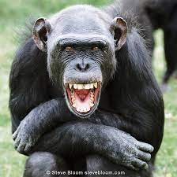
The chimp!
ill-equipped
panics
In survival mode
Paranoid
Believes in conspiracy
Will do anything to stay safe
Notes:
Insecure, ill-equipped to meet the expectations, no skills, no strengths, scared to fail, expecting everything to go wrong!
Endless information in the logical brain of experiences where it all ends in tears or failure, humiliation or hurt. There is no information regarding a good resolutions, So the Chimp brain says RUN to save yourself from everyone who is trying to hurt you. Let them know not to mess with you – threaten them so they stay away from you then run.

Slide 12
On guard
Beginning to panic
Planning to stay safe
Preparing for fight or flight
Paranoid
Feeling like you can’t cope
Notes:
WE are going into chimp mode when we run out of logical information
We need a bank of strategies and NEVER rely on our emotions to feed us that information (Chimp)

Slide 13
Activity
Share a time when you felt like this.
A situation is kicking off and you are unsure how to deal with it
No one can come and help and you are panicking as you feel very alone and worried
You don’t feel safe and want to leave the room but can’t
Fear begins to build in you but the children in the room are staring at you waiting for you to resolve it
Notes:
Being vulnerable helps others to see what your needs are and how your emotional brain tries to wrap you up in cotton wool to protect you, when we can protect you with strategies

Slide 14
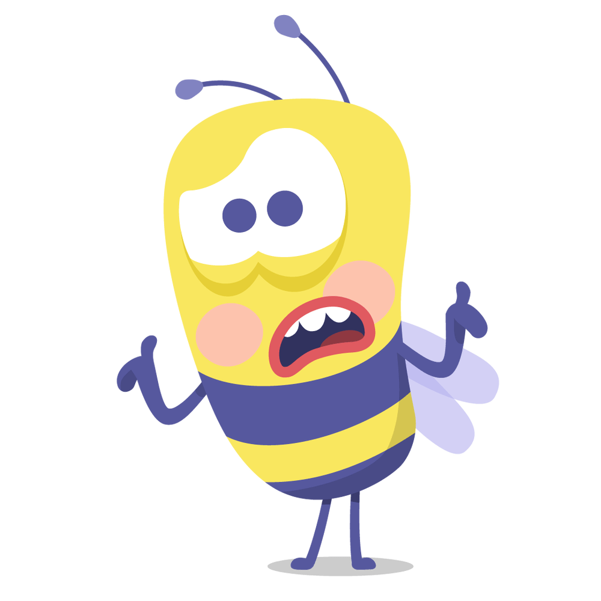
Someone needs to be in logical brain…..the alternative is we have two chimps trying to sort out this mess!!!!
Input information/strategies into the logical brain….. FAST!
Notes:
Know when you are in CHIMP and know when they are in CHIMP
You need to remove yourself from the situation if you have run out of information in the logical brain (strategies) or gain more…quickly!

Slide 15
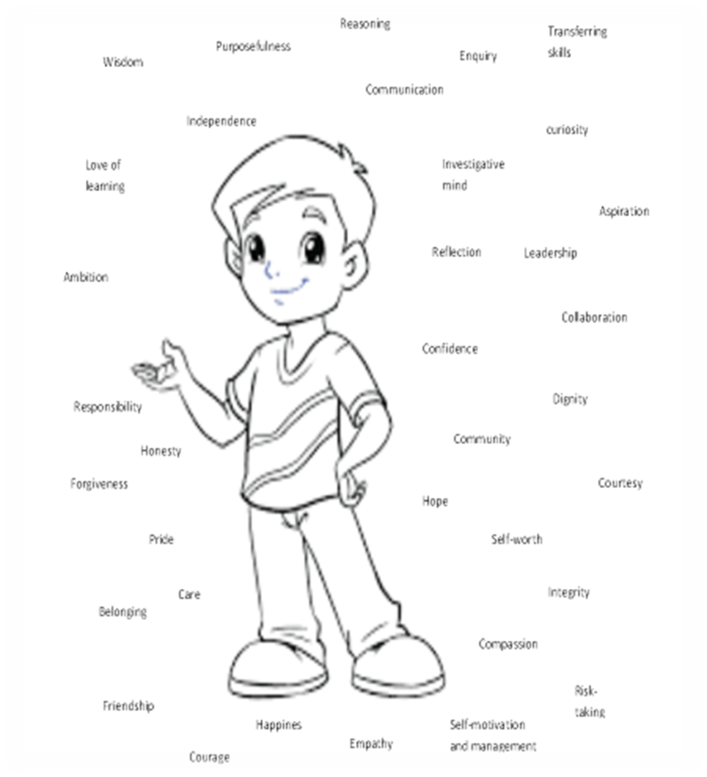
Why do I have to do all this?
A sense of self
Social/emotional
Family
Relationships
Tom
A sense of others
Culture
Peers
Staff
A sense of the world
Curriculum
Notes:
Why do I have to do all this?
Tom needs you – you are all that he has left!

Slide 16
Fill the child’s head with logical responses to call on
(social stories)
Teach them about their chimp and how it is just panicking
(hand over control)
Scripts!
Repeat, repeat, repeat
‘computer says no’
Notice when you are moving into chimp mode – only use logical information
(strategies)
What can we do to stay in logical mode and not become a chimp?
Stability/security recognise the response
(Behaviour policy – clear/concise)
When they panic give them an exit route
(practise how to get out)
Create opportunities to avoid the child feeling unsure so wont panic
(scaffold)
Remove all fear!
Know the child’s triggers
(observe)

Slide 17
I want a compassionate classroom……what can I do about it?
Sense of self:
Give Tom responsibilities
Give him Leadership opportunities, Self growth opportunities, Input into his learning
Give him time to share his ideas
Give him a voice in the school
Let him make changes
Give him chances to work on projects that have a huge impact in his community
Give him a chance to fail, followed up by reflection and celebration
Let Tom have the time to speak to others about his achievements – be an ambassador
Sense of others:
Give Tom a chance to help others as part of a team of ambassadors
Give him responsibilities around other people
Give him time to get to know others
Give him opportunities to support other people and celebrate his and their achievements
Help Tom to learn about the people around him
Help Tom to gain empathy and understanding of all events affecting others
Give Tom time to work on charity work
Let Tom be a mentor /coach
Sense of the world:
Let Tom participate in his learning journey by planning with you
Create a curriculum with projects he can help to plan and execute with real outcomes for the world
Help Tom to make the world a better place – reality and purpose
Teach Tom how to be a global citizen
Help Tom to be confident online and use it to communicate with the world
Help Tom carve his place in the world before he leaves school – know where his strengths are needed and valued

Slide 18
The compassionate people around the child
Staff
Praise
Happy to see child
Smile at child often
Wave to child
Thank them
Apologise to them
Nurture child
Be interested in what they say
Listen to them
Value their opinion
Talk about them positively
Check in on them
Celebrate them
Reassure them when they make mistakes
Help them
Trust them
Trauma Informed B Policy
Maslow before Blooms!
Parents
Unconditional love
Forgiveness
Know their gifts/talents
Understand them
Reassure them
Listen to them
Champion them
Praise them
Like them
Talk about them positively
Nurture them
Basic needs met
Relationships are formed leading to:
Feeling needed/wanted
Feeling cared for
Feeling valued
Feeling loved
Feeling liked
Peers
Loyalty, friendship, challenge, forgiveness, accountability, compromise, debate, equality, laughter, fun.

Slide 19
Strategies:
Scripts – have one prepared in your logical brain to draw upon - EVERY answer needs to be in the logical brain ready to pull out when needed! (Care Plan – Dos and Donts for Tom)
Words – know the child and what words they need to hear right now
Exits- know if they need to exit quickly and make it safe for them
People – know who helps them to calm their chimp and pair them up
Environment – have clear rules and options set out
Furniture – keep spaces clear of obstacles
Expectations – don’t set expectations they can’t meet
Strengths – only allow them to use their strengths in school, never their weaknesses
Tools – know them to know what tools they need
Triggers – know their triggers and mitigate against them
Most important:
Introduce them to their Chimp! Give them a guide on how to manage their Chimp and support them to do that
Notes:
Every child who is in chimp must have a strategy box – do this, don’t do that! Be consistent – boring and predictable

