Slide 1

Working in partnership with Ofsted

Slide 2

Prepare well ahead of time!
Know the rules of play!

Slide 3

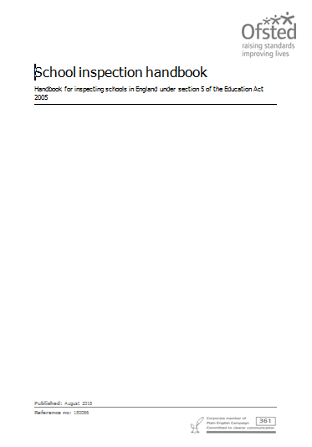
Section 8
Section 5

Slide 4
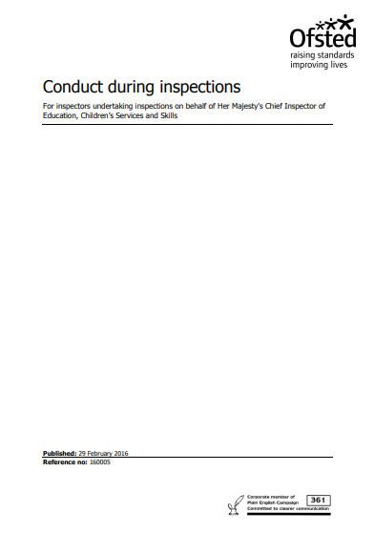
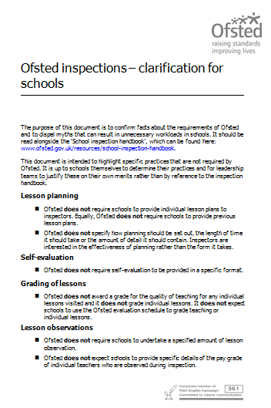
Code of conduct
Ofsted updates

Slide 5
What? | Who? | Completed? Updated
EYFS predicted GLD for July 2017 | Caroline
Phonics Y1 and Y2 | Maria
Updated Ontrackness for every year group (from October) | Julie
Updated progress for all groups | Julie/Kate
Updated Data Summary sheet | Julie/Kate
Combine predicted attainment with SEN/PP | Julie
Progress from end of FS – Y2 (present Y3) | Julie
Attendance of all groups PP/SEN/Boys/Girls | Alexis/Jane/Kate
Updated SEF | Julie
Accessibility plan/ Security risk assessment | Julie
Topic webs/curriculum info on website | Alexis
Data information on website for July 2016 | Alexis/Julie
Policies update and on website (inc new marking one) | Alexis
Case studies of low ability boys | Julie
Case studies of exclusions (internal and external) | Julie
Case studies of open cases with CP/Social Care | Julie
Record of referrals to DSL and outcomes | Julie
Summary of yearly objectives in SDP | Julie
School timetable with times on | Alexis
Staff list with responsibilities | Alexis
Record of bullying incidents (inc homophoic or racist incidents) | Julie
Evaluation of teaching and learning | Julie
Appraisals and pay increases | Julie
Paperwork to show any move toward Acadamisation | Alexis
SEP reports – advice followed | Julie
SIAMS report | Julie
Delegate tasks!

Slide 6
Set out the day…. (Walk through the day)
Timetable for the day – what will show off your best assets?!
Opportunities to ‘bump’ in to staff who are positive
Prep the children who want to talk to the Inspectors
Delegate tasks throughout the day – open the door, sign in badge, making tea, tidy areas etc
Prepare for the unknown – snow, flood, electricity outage!
Find a Governor who is strong enough to encourage you through the day
Find another Headteacher locally who can come and sit beside you if you feel things are not going to plan
Prepare, prepare, prepare…..at least a year in advance!

Slide 7
What if the day is not going too well?

Slide 8

Take some time out to review the guidance:
Is the inspector following the guidance?
Is the inspector following the agreed format?
Is the inspector following the code of conduct?
Sit down and write down all the reasons you feel it is not going well….is it you? Is it them?
What needs to change?

Slide 9


So it seems the inspector is not following the guidance and has their own agenda!
But what can I do?
Stop the inspection!
Share with them the guidance and remind them of their duty to work with you
Share yours and their code of conduct
Give them a ‘polite warning’ and a clear idea of what needs to change before the inspection can continue – agree this!
Thank them for reviewing their conduct!
Ensure your Governor has noted everything.

Slide 10

It’s all gone pear shaped!!!!
Stop the inspection! (again)
Have a reason (guidance/code of conduct) to ask them to leave
Remind them of the polite warning and be clear of the expectations, for example, ‘I would like you to go back to the Head office and ask for another inspector to come and carry out an inspection where the guidance is followed..’
Begin to collect evidence of the inspection being flawed in readiness to make a full and comprehensive complaint.

Slide 11
What does a good complaint look like?
Intro – the complaint is about a person, not the organisation. It is to improve working partnerships with schools.
The facts – what happened? Clear reference to the statements in the Code of Conduct and/or guidance.
Do not use emotion unless factual. ‘The girl was crying and frightened to talk to the inspector which made us all very uncomfortable as it is our ethos that all children feel comfortable and emotionally safe.’ This became a safeguarding issue for me as DSL.
Interview all staff and use their words to back up your complaint.
Offer a resolve. (ask for another inspection based on the fact that the inspector did not follow legal guidance).
Use the evidence you have collected to refer to:- quotes from staff, children and Governors, data which contradicts the inspectors key priorities or reflection etc.

Slide 12


Remember
You are never alone;
You know the rules of the game;
You are the DSL;
You know your school – they do not;
You have all the evidence they are looking for;
Your staff and children expect you to keep them safe;
You have worked hard… show them;
You have every reason to work with Ofsted not against them;
You are in control! Take regular breaks to eat, drink and think…
You can complain – not whinge!

